Slide 1
Generator interconnection
Application submission tool
User guide

Slide 2
Table of Contents
3. User Registration / Sign in
8. Home Screen
11. Account Details
14. Company Management
22. Application Submission
45. My Projects

Slide 3
User Registration/ Sign in

Slide 4
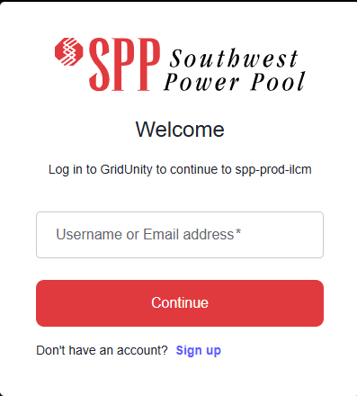
User Registration / Sign In
Navigate to https://sims.spp.org/login
Existing users sign in using username or email and password.
1
2. New users navigating to the portal’s publicly accessible webpage register a user account by clicking Sign Up.
2

Slide 5
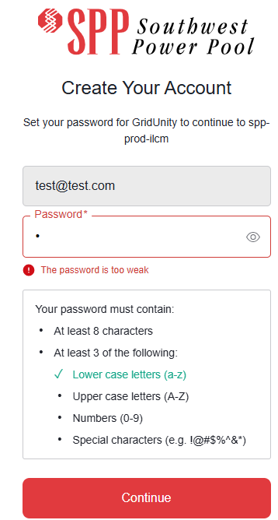
User Registration / Sign in | Sign Up
To register as a new user, click “Sign Up” button, then follow User Registration flow by entering:
Username / Email address
Password
Click “Continue” to register
1
2
3
Note: User registration process may vary for systems with integrated Single Sign On (SSO) support.

Slide 6
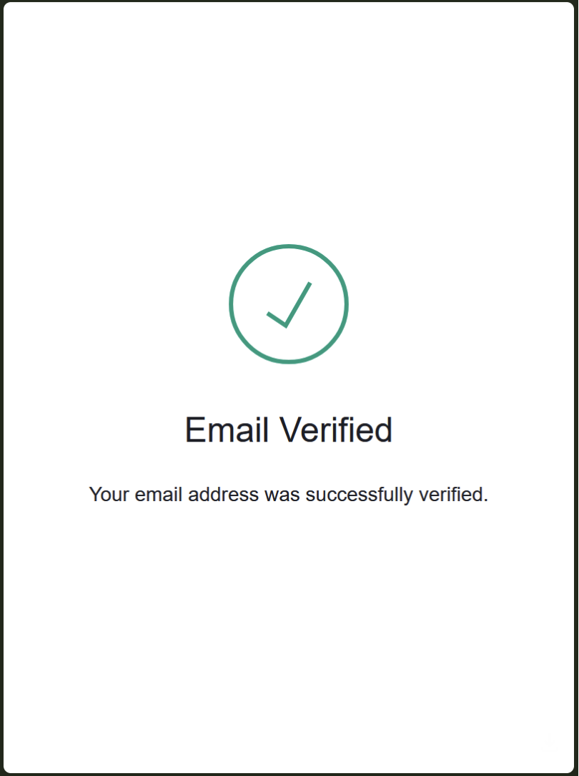
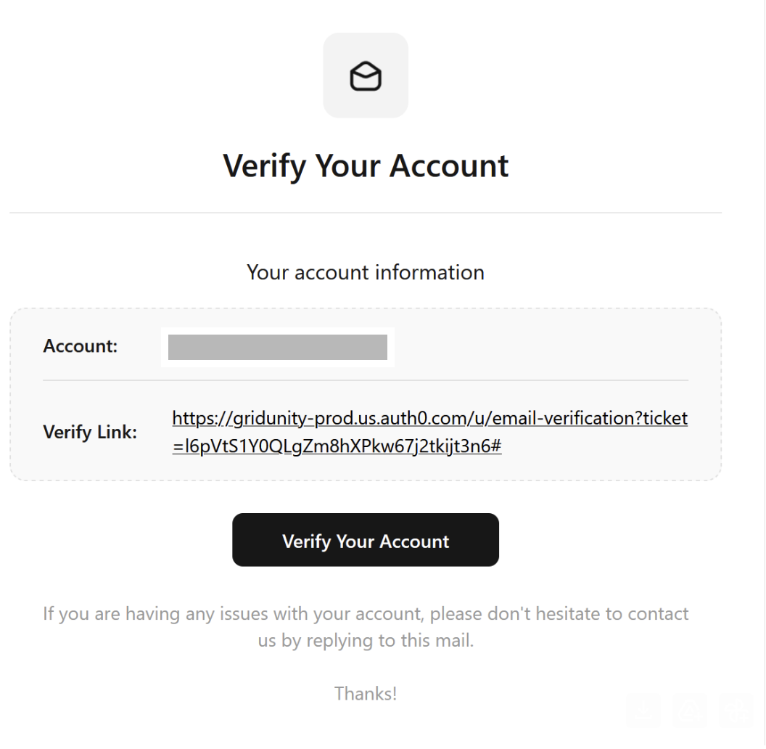
User Registration / Sign in | Sign Up
Click verify link from email to confirm registration.

Slide 7
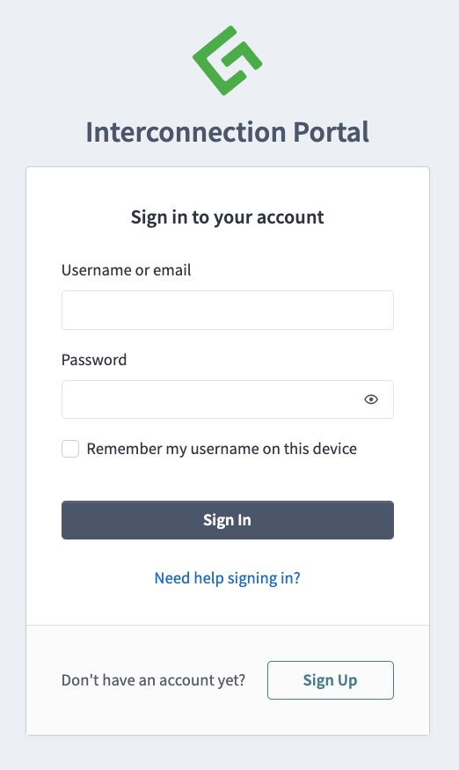
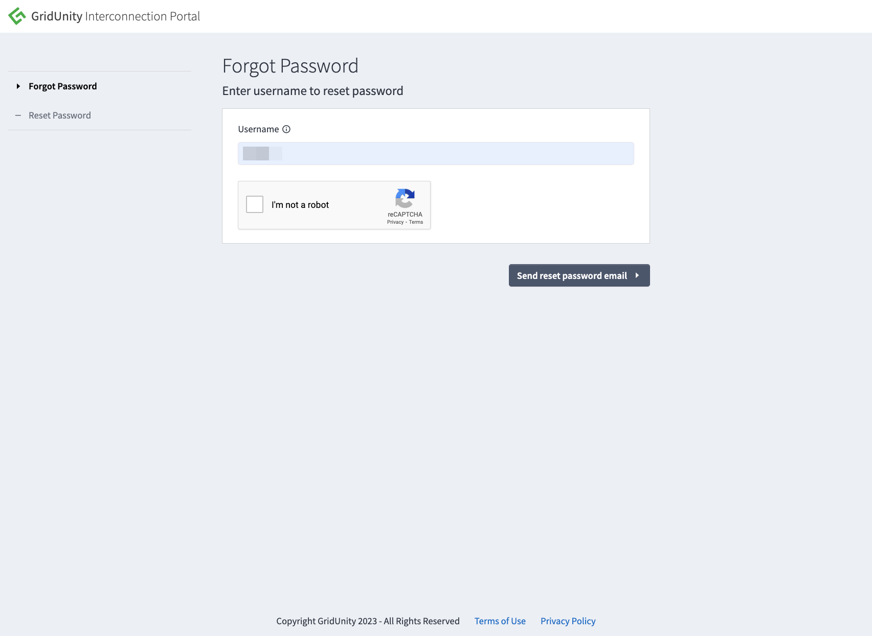
User Registration / Sign in | Forgot Password
For sign in support:
1. Click “Need help signing in?”, then
2. follow Forgot Password flow.
2
1

Slide 8
Home Screen

Slide 9
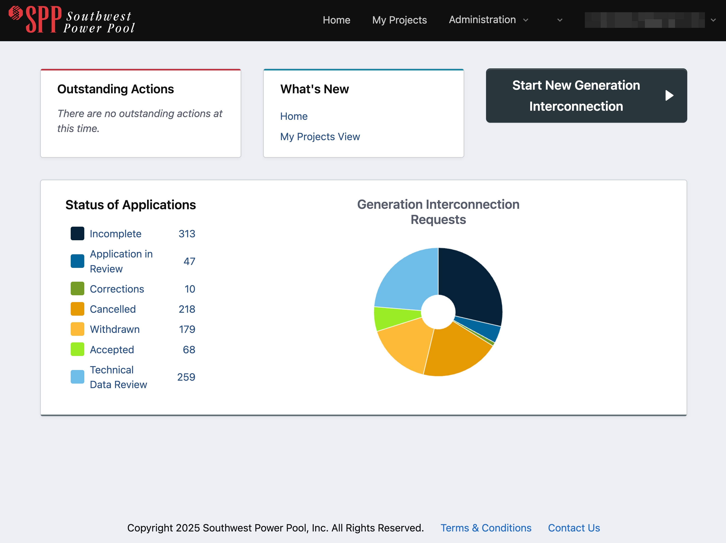
Home Screen
1. Global Navigation Menu
Present on all pages. Provides user ability to navigate throughout system.
2. Outstanding Actions
User-configurable summary of projects requiring important actions. Includes links to filtered list of relevant projects for easy access.
3. What’s New
Quick access to new or important system or business process information.
4. Status of Applications Dashboard
Configurable view of applications summarized by status category including links to My Projects page view filtered by that status.
5. Start New Application
Button used to start new generation interconnection applications.
1
2
3
5
4

Slide 10
Home Screen | Global Navigation Menu
1. Home
Returns user to home/dashboard screen.
2. My Projects
Summary grid view of all projects the user has access to.
3. Administration
Only accessible to administrative user roles. Provides access to user management, company management and other administrative functions.
4. Account
Provides access to account details, address book, and sign out function. Also provides user options to Join or Register a company.
1
3
4
5
1
2

Slide 11
Account Details

Slide 12
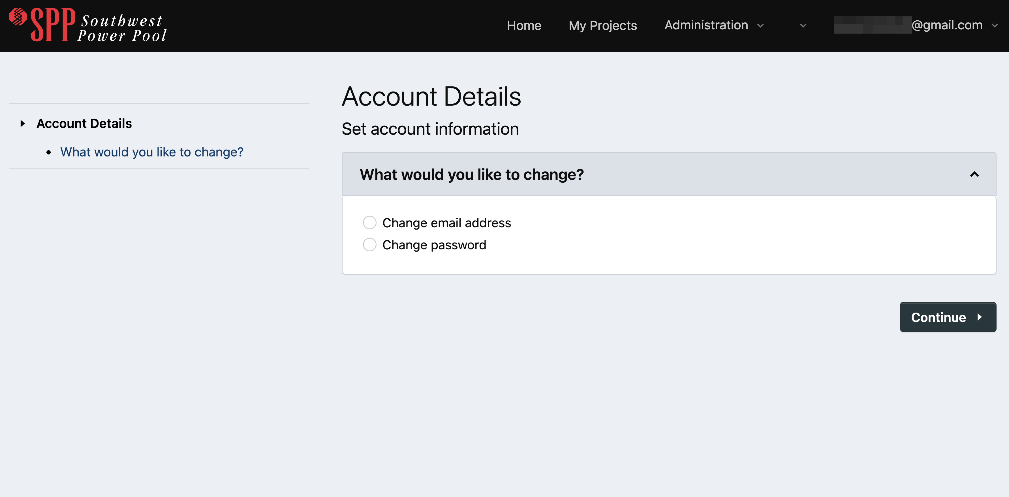
Account Details
The Account Details screen provides the user with options to:
Change email address
Change password

Slide 13
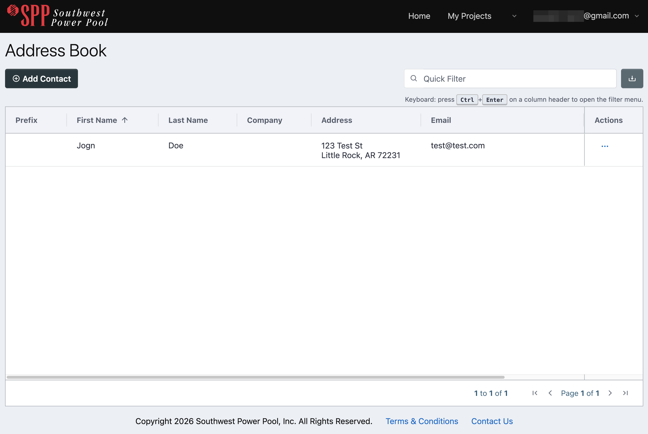
Account Details | Address Book
The Address Book provides a view of user’s contact information as provided when the user registered.
This information is also used when using the “Copy From” feature in the Contact Information section of the application submission process.

Slide 14
Company Management

Slide 15
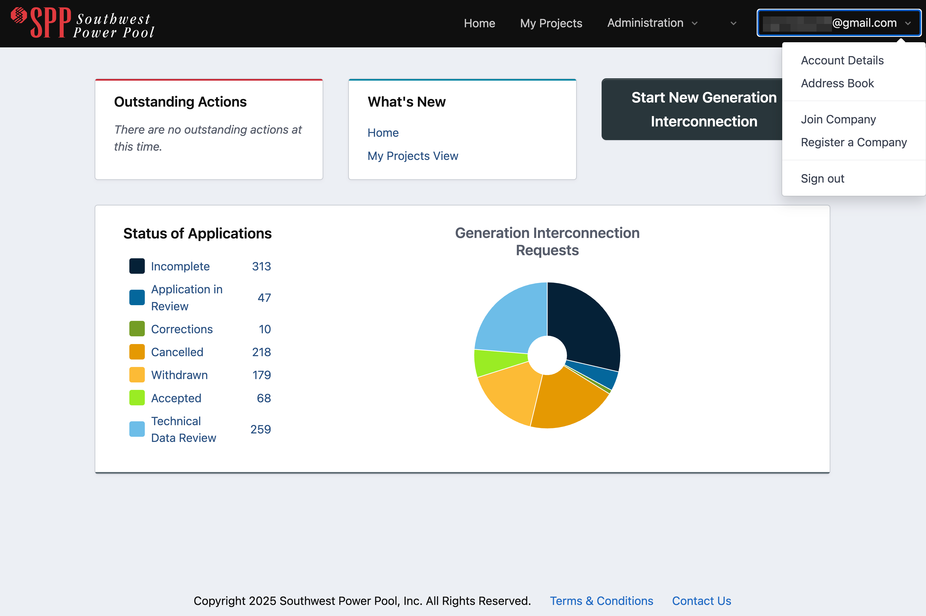
Company Management | Join a Company
To request to join an existing company as a member:
Click your User Name in global navigation menu bar, then click Join Company.

Slide 16
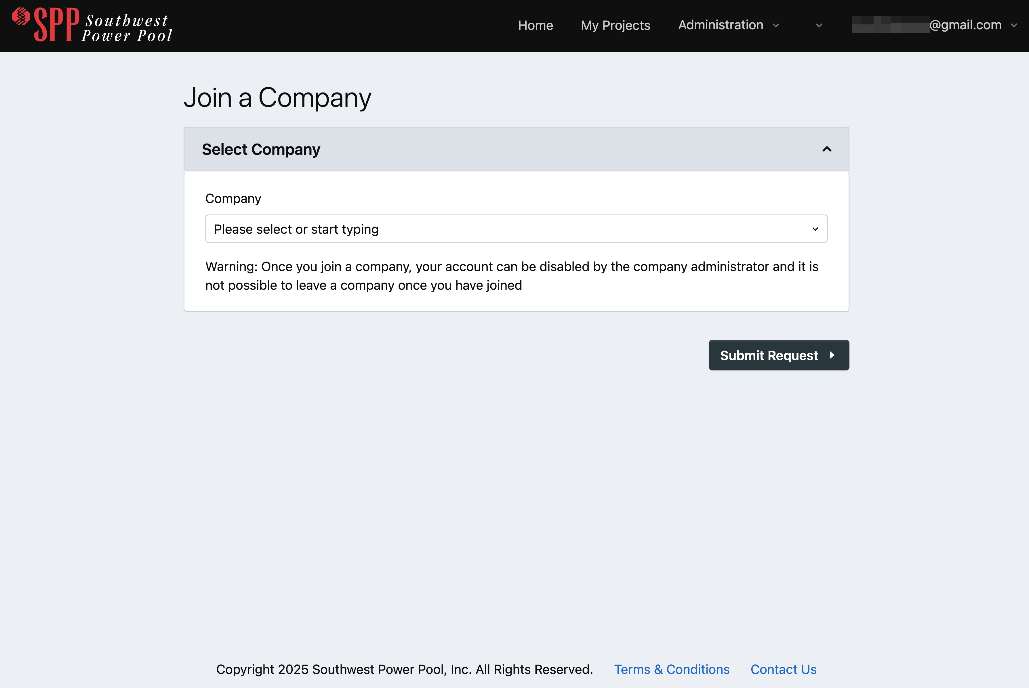
Company Management | Join a Company
Type to search or click dropdown list to select a company to join.
Submit request.
An email will be sent to the company administrator prompting them to review and approve your request.
You will receive an email with the results.

Slide 17
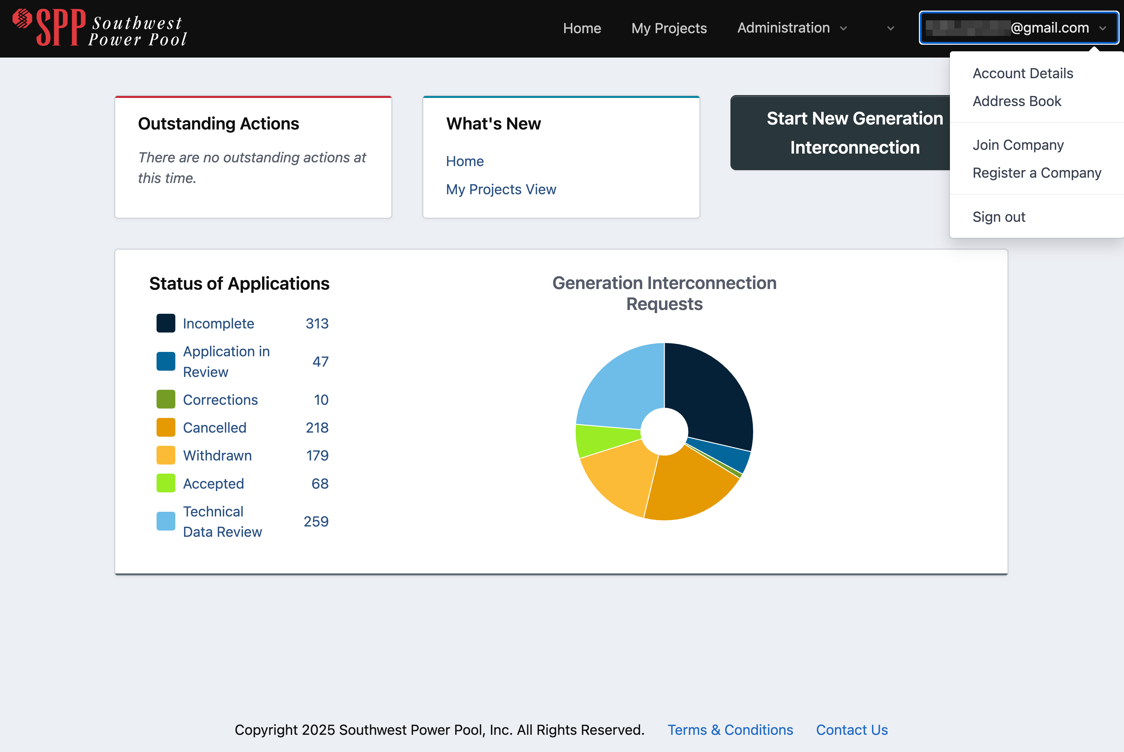
Company Management | Register a Company
To request to register a new company in the portal, click your User Name in the global navigation bar, then click Register a Company.

Slide 18
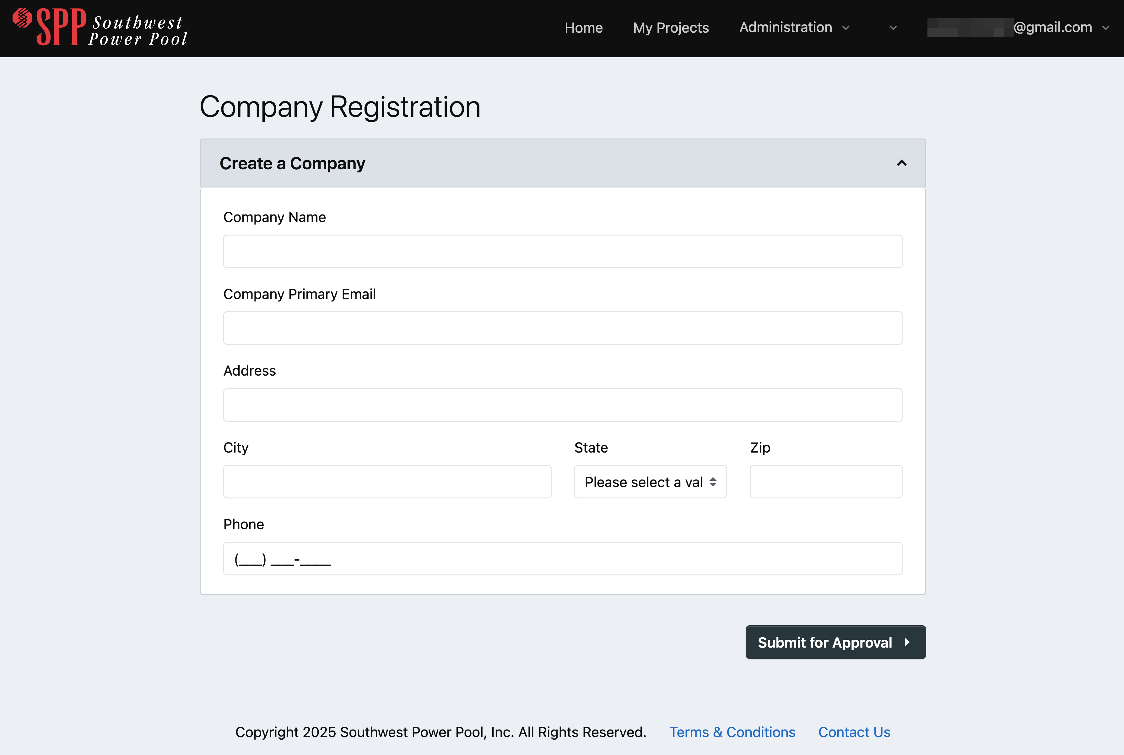
Company Management | Register a Company
Fill in company details
Click Submit for Approval.
An email is sent to the system administrator to review and approve/deny your company registration request.
You will receive a separate email with the results.

Slide 19
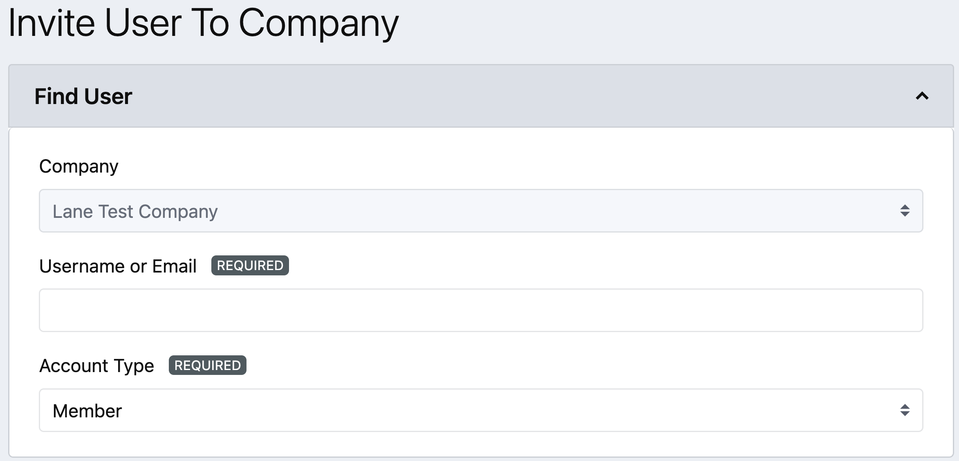
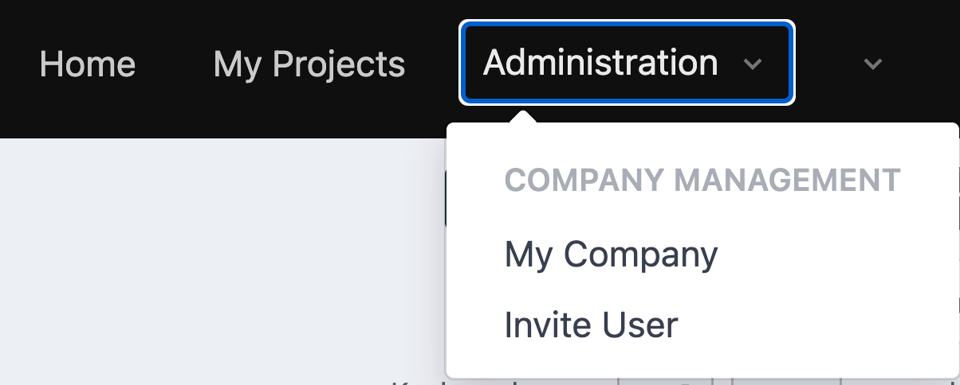
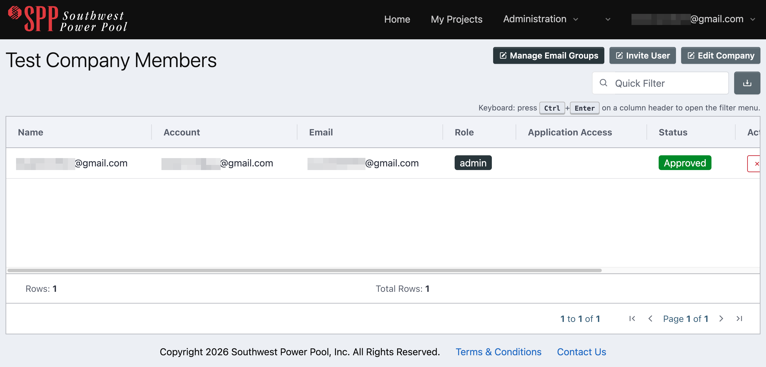
Company Management | Administering a Company
Once you register a company, you become the administrator of that company and can manage your company through the Administration menu.
Here you can:
Edit company details
Invite new members to your company
Manage membership and member access to company projects
Note: You can also be promoted to be a company administrator by the acting company admin after you join a company as a member.

Slide 20
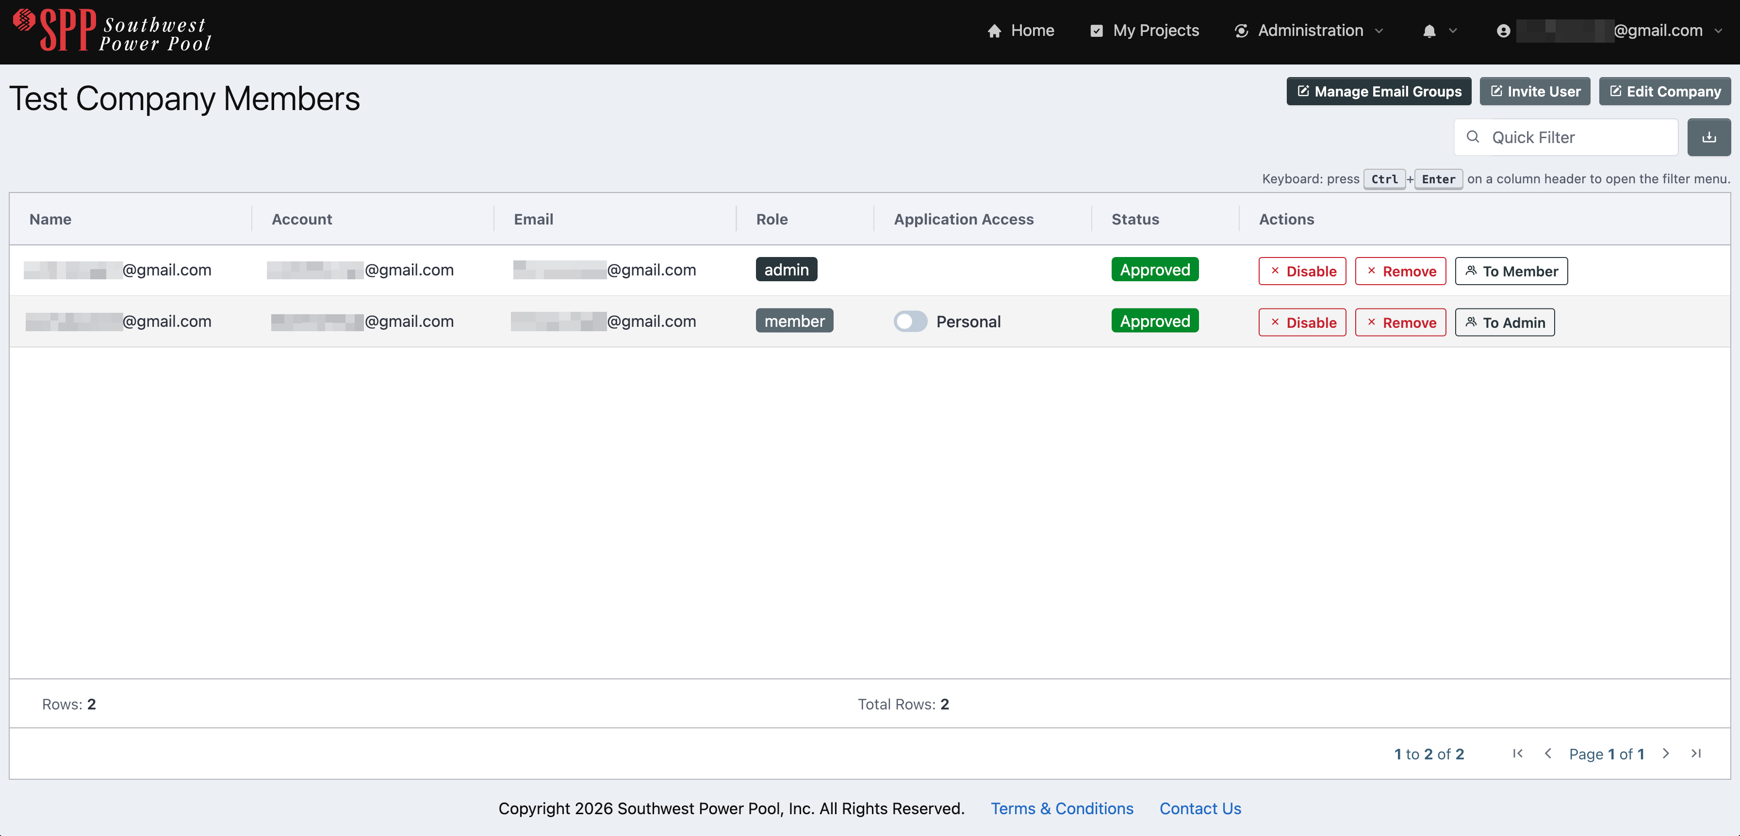
Company Management | Administering a Company
To manage company membership and access levels, visit the My Company page. Here you can:
1. Search, sort, filter, and view company member details
2. Toggle each member’s access between personal and all company projects
3. Approve / reject new company join requests
4. Disable members
5. Promote other members to have Company Admin responsibilities

Slide 21
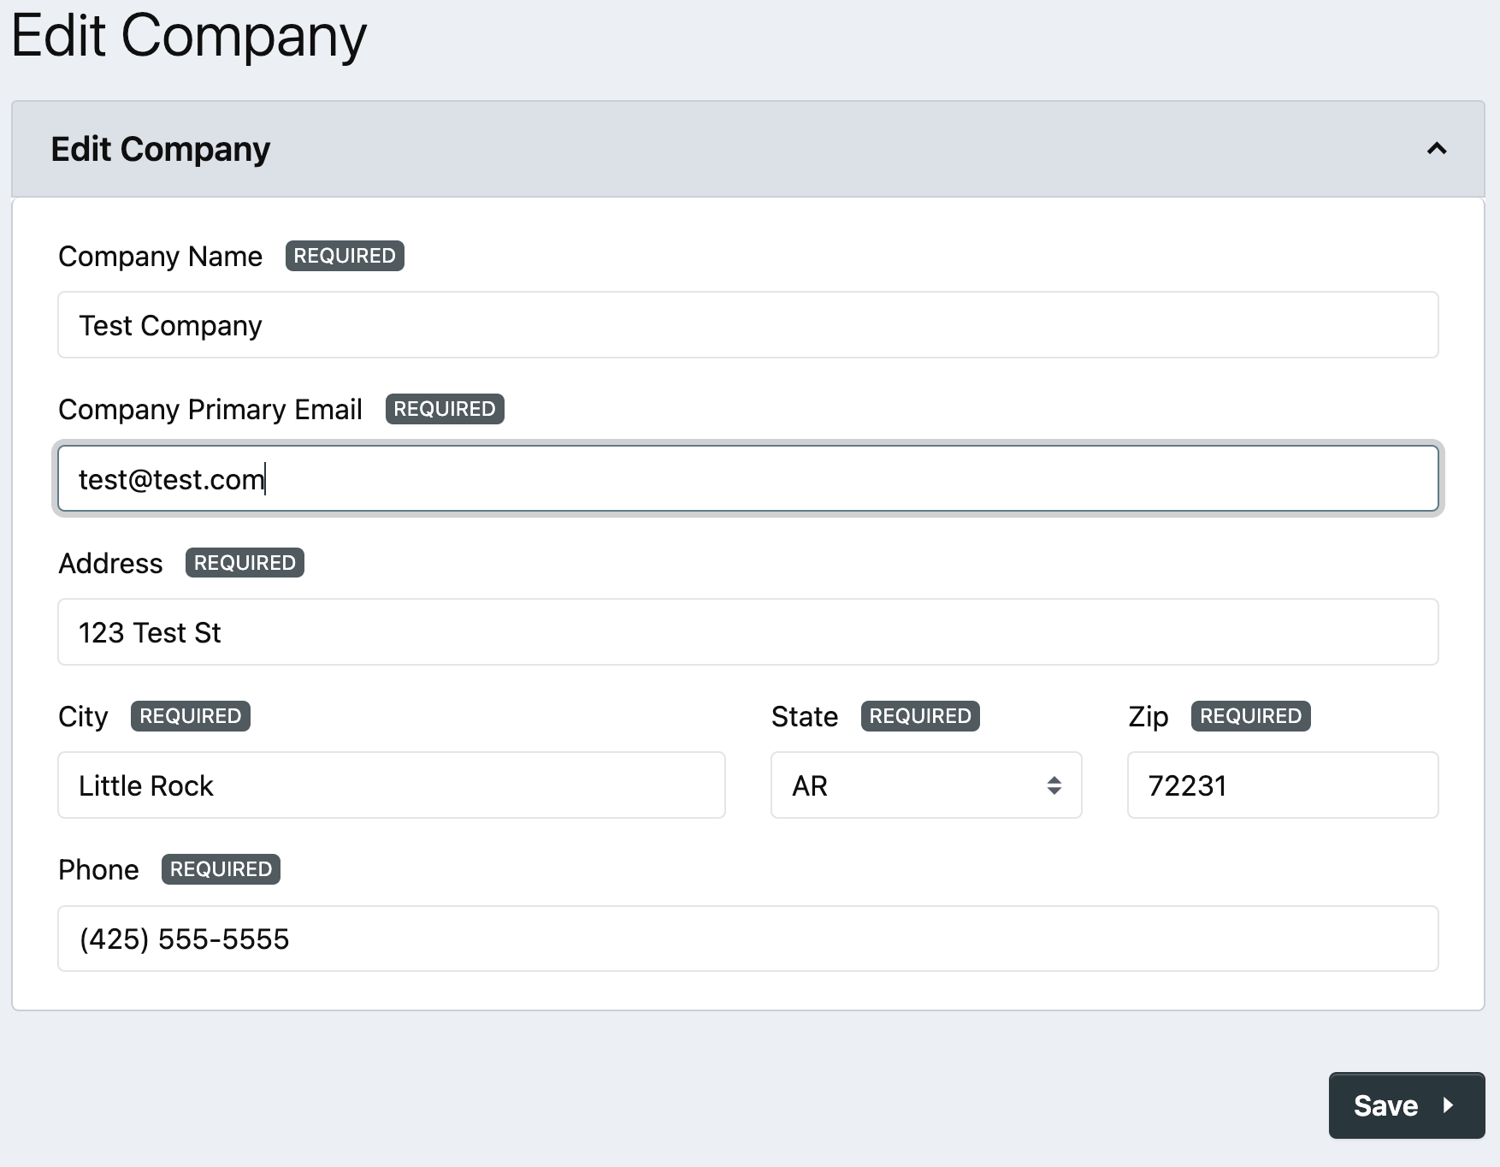
Company Management | Editing Company Properties
Company administrators can edit their company’s details by clicking Edit Company from the My Company page.

Slide 22
Application Submission

Slide 23
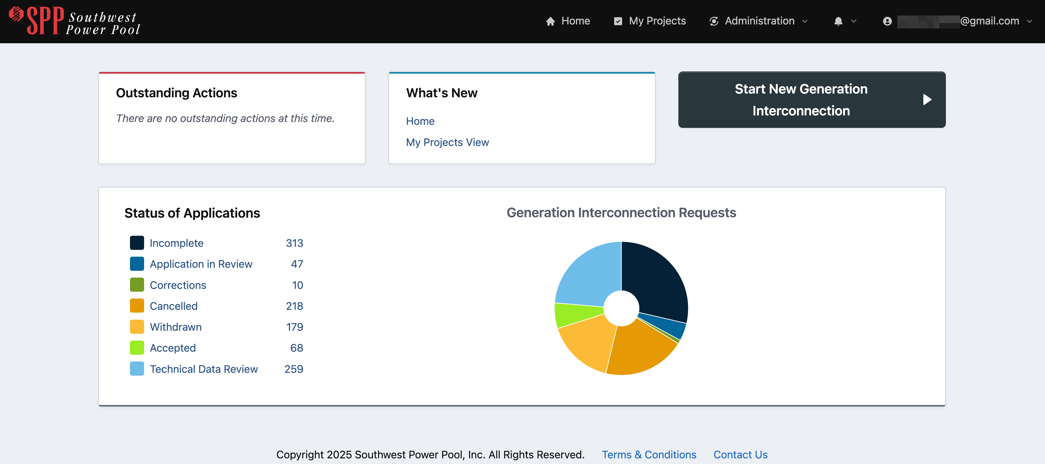
Application Submission
Start New Generation Interconnection button from the Home screen allows a user to proceed to the Program Selection screen to select the application request type to be entered.

Slide 24
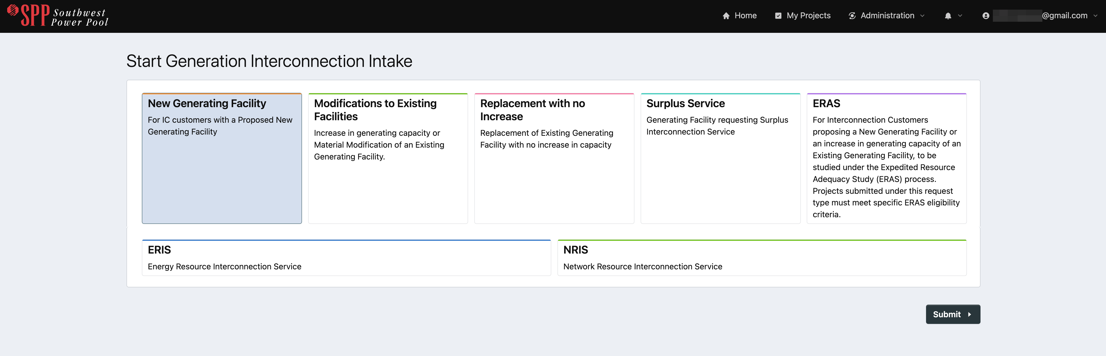
Application Submission
Start Generation Interconnection Intake is the first activity within the application submission process. Two categories define the Interconnection Request:
Program type of the interconnection request
The Service Type for the request
1
2
2

Slide 25
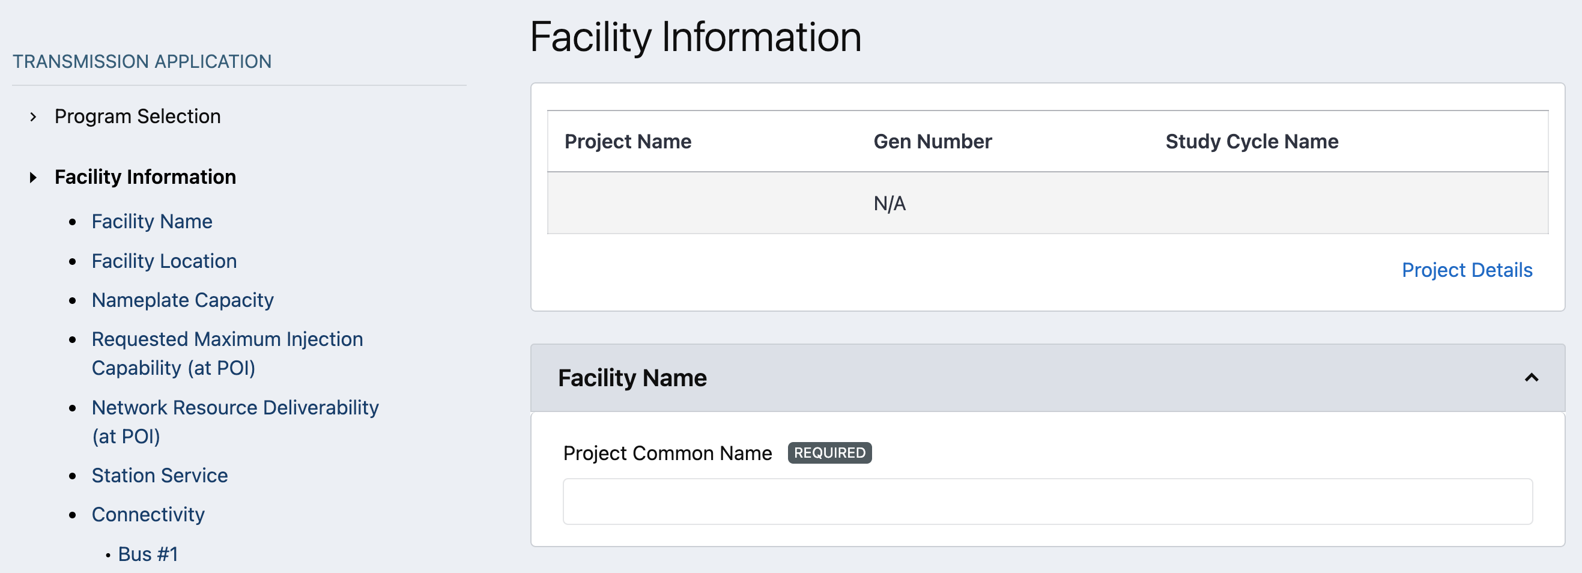
Facility Information
Facility Information activity captures pertinent information of the facility:
Facility Name and Location
Latitude/Longitude
Installed Generating Facility Capacity
Net Output as measured at POI
New or Existing Service
Station Service
Connectivity

Slide 26
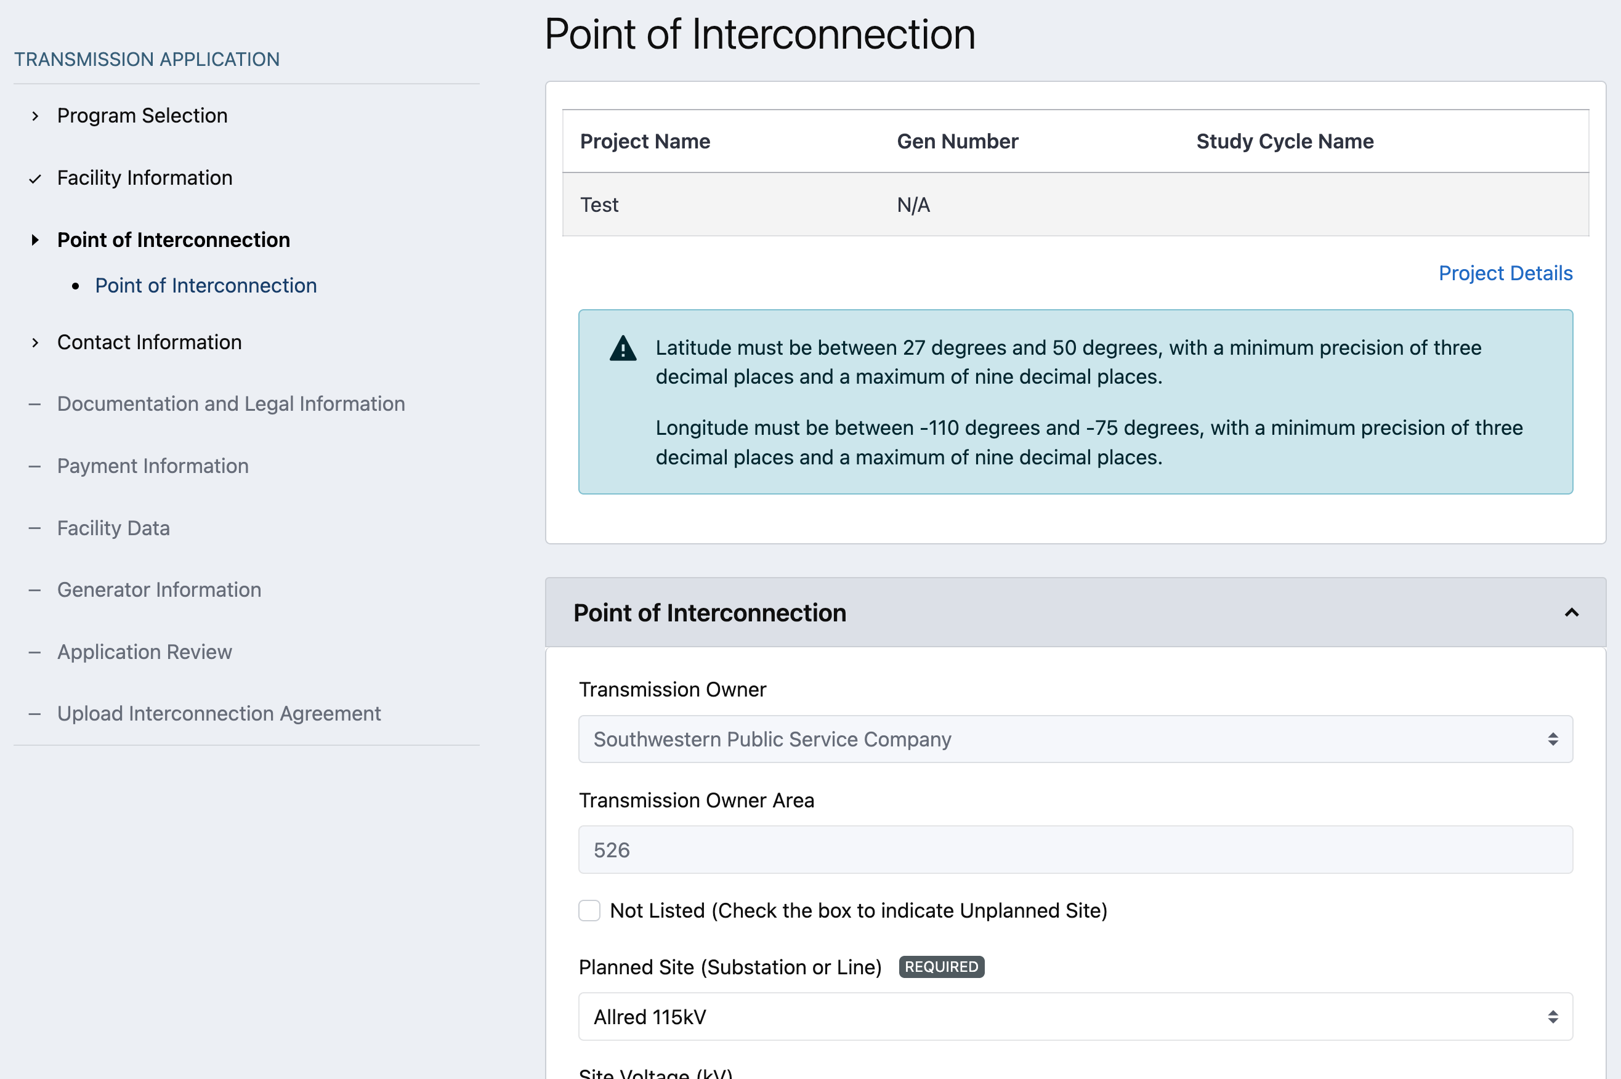
Point of Interconnection
Point of Interconnection need more:
Planned on Unplanned Site
POI details

Slide 27
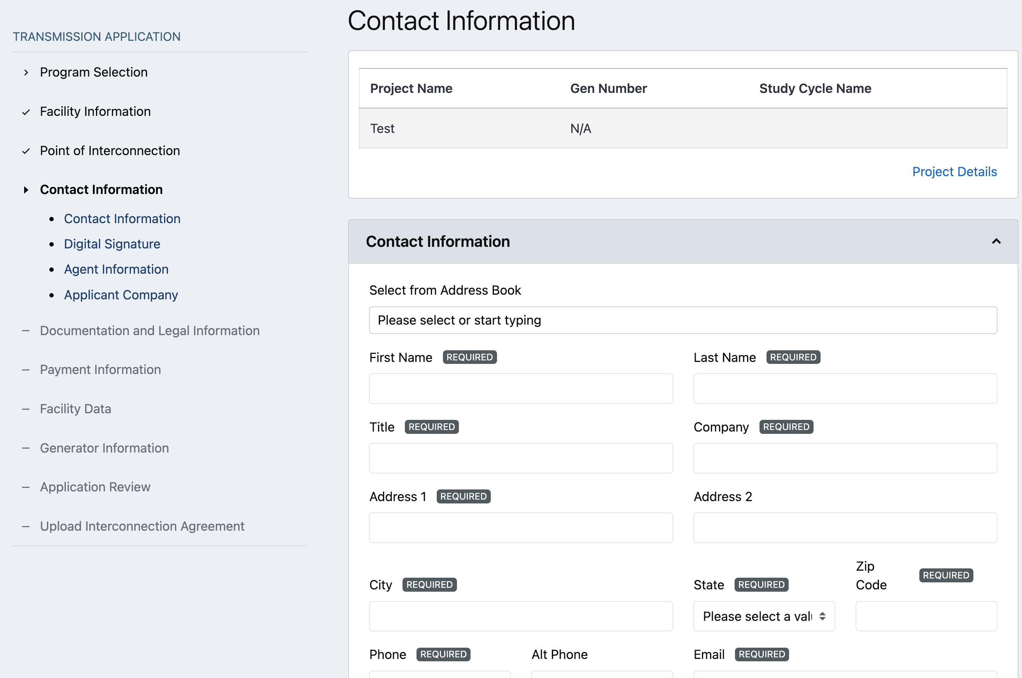
Contact Information
Contact Information captures important contact information for Applicant and Agent:
Contact information of applicant
Digital Signature to designate a different document signer other than applicant
Agent information if applicant has an agent
Applicant Company information

Slide 28
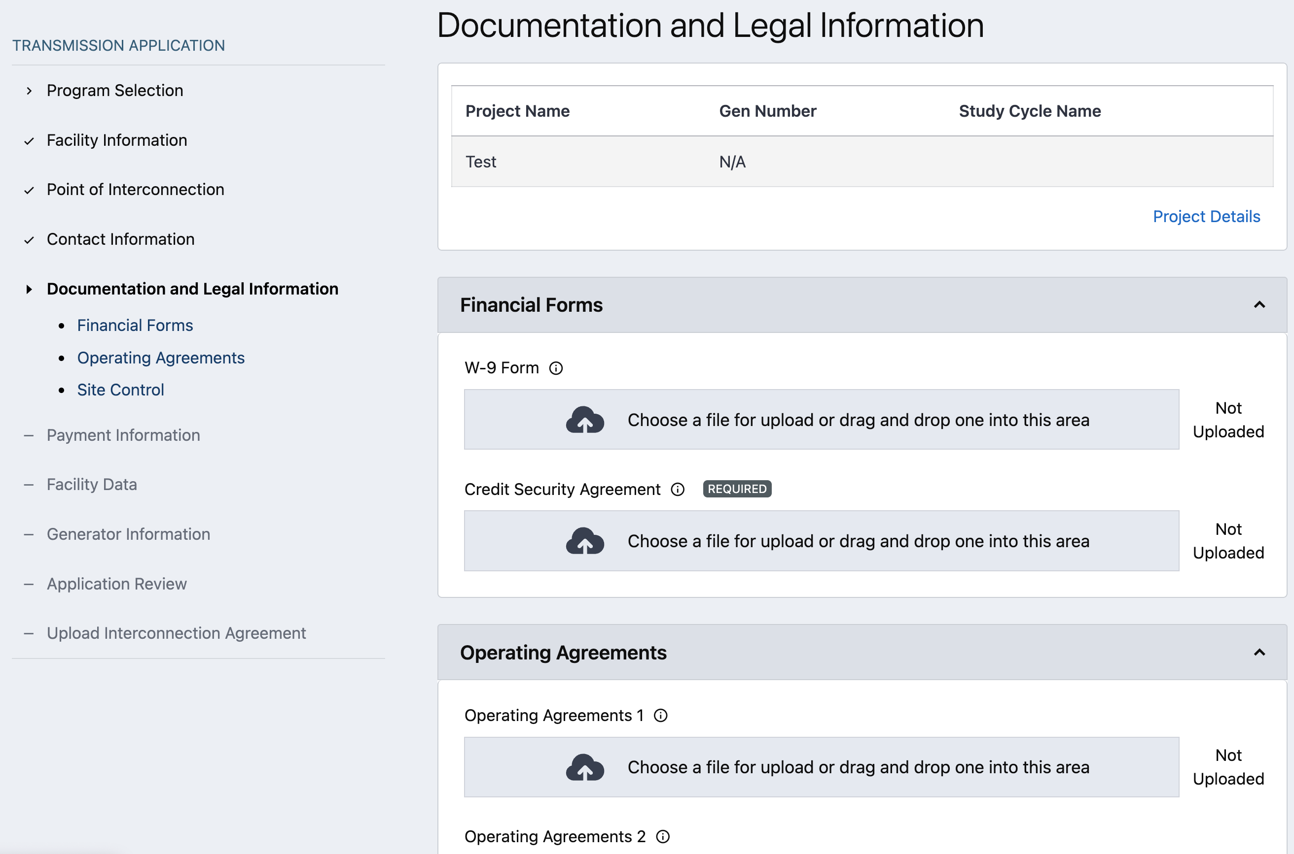
Documentation and Legal Information
Documentation and Legal Information captures relevant legal documents needed for the application process:
State or Federal Tax Form (W-9)
Operating Agreements (allow up to 5)
Site Control documents

Slide 29
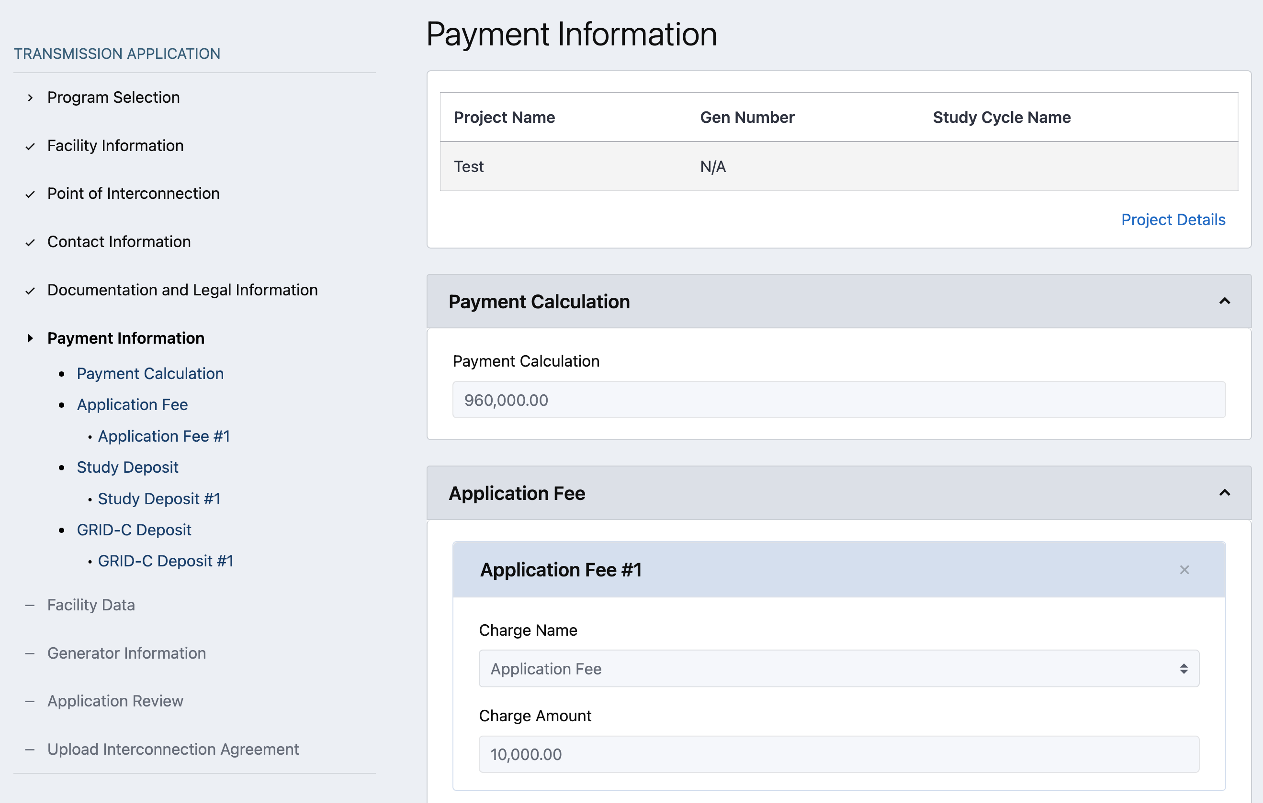
Payment Information
Payment information captures how payment will be made, the calculated cost, and banking information:
Payment Type
LOC, ACH/Wire
Payment Calculation
Program selection
Banking Information

Slide 30
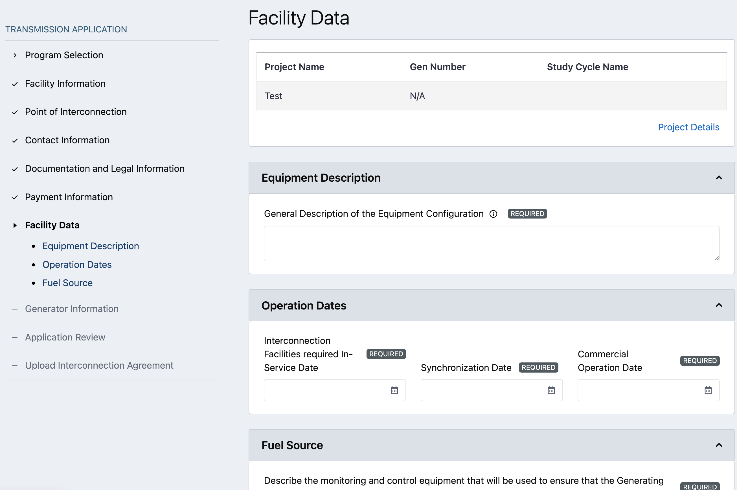
Facility Data
Facility Data captures the facility data for the requesting application.
Equipment Description
Operation Dates
Fuel Source
Single or multi-select

Slide 31
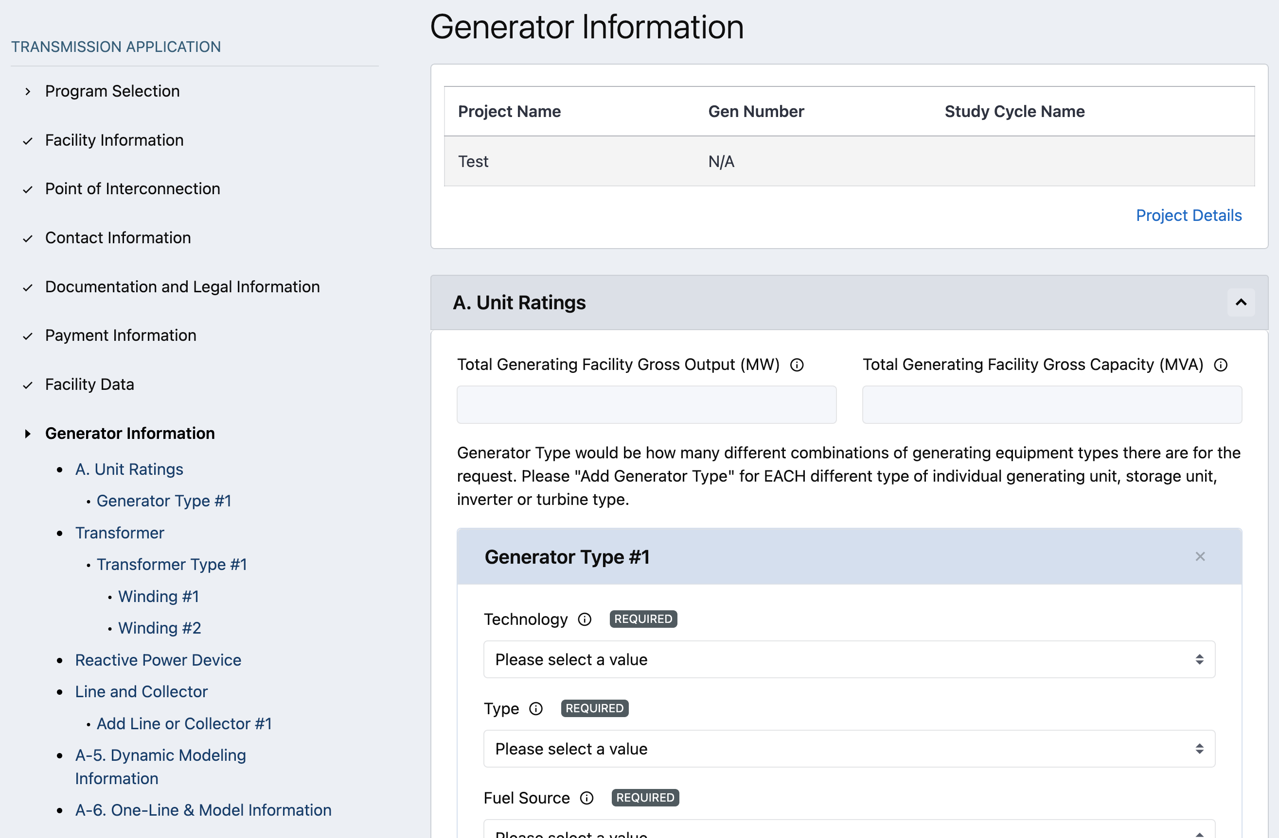
Generator Information
Generator Information captures information related to the Generators, Transformers, Tie Line and Impedance data, as well as One-Line and Model documentation.
Unit Ratings (Generator Type)
Allows for 1 or more Generators
Short Circuit Information
Transformer
Allows for 1 or more Transformers
Reactive Power Device
Tie-Line and Collector Information
Allows for 1 or more Tie-Lines
System Equivalence Impedance Data for Wind/Photovoltaic plants
Allows for 1 or more Impedance Data
Dynamic Modeling Information
One-Line & Model Information

Slide 32
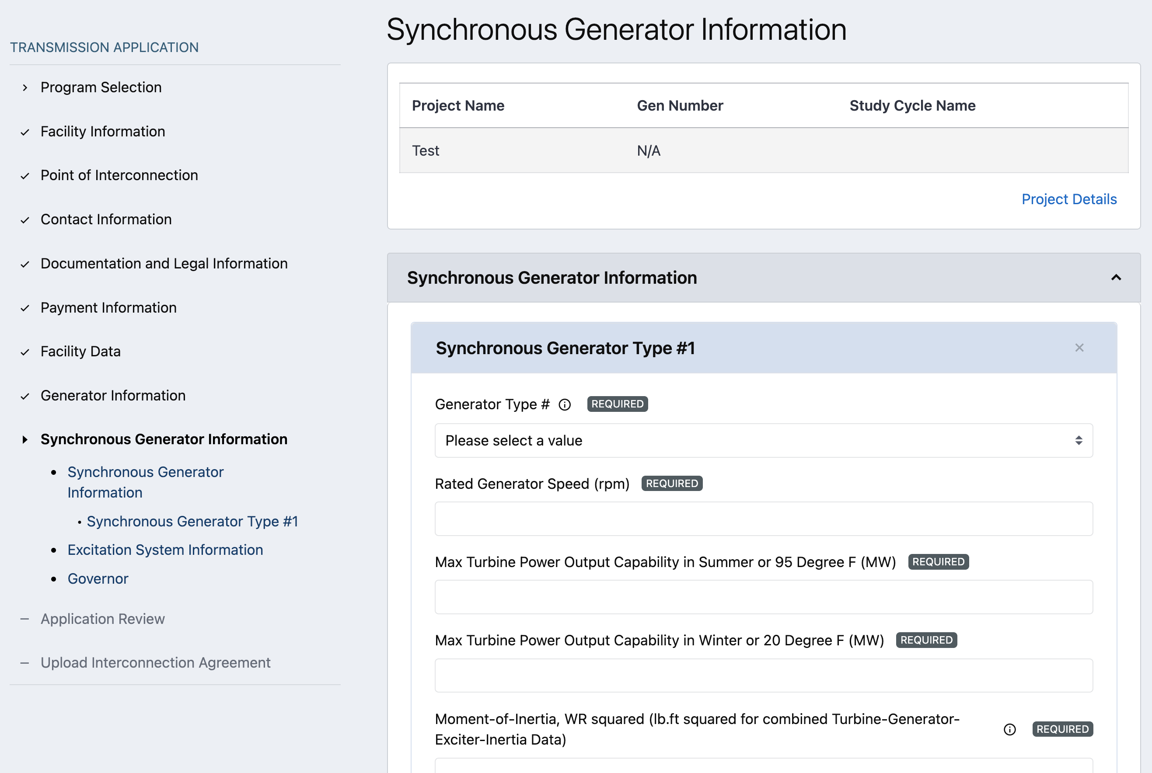
Synchronous Generator Information
Synchronous Generator Information captures information for Synchronous Generators. This section is only applicable when specific fuel sources are selected.
Synchronous Generator
Excitation System
Turbine Governor
Induction Generator

Slide 33
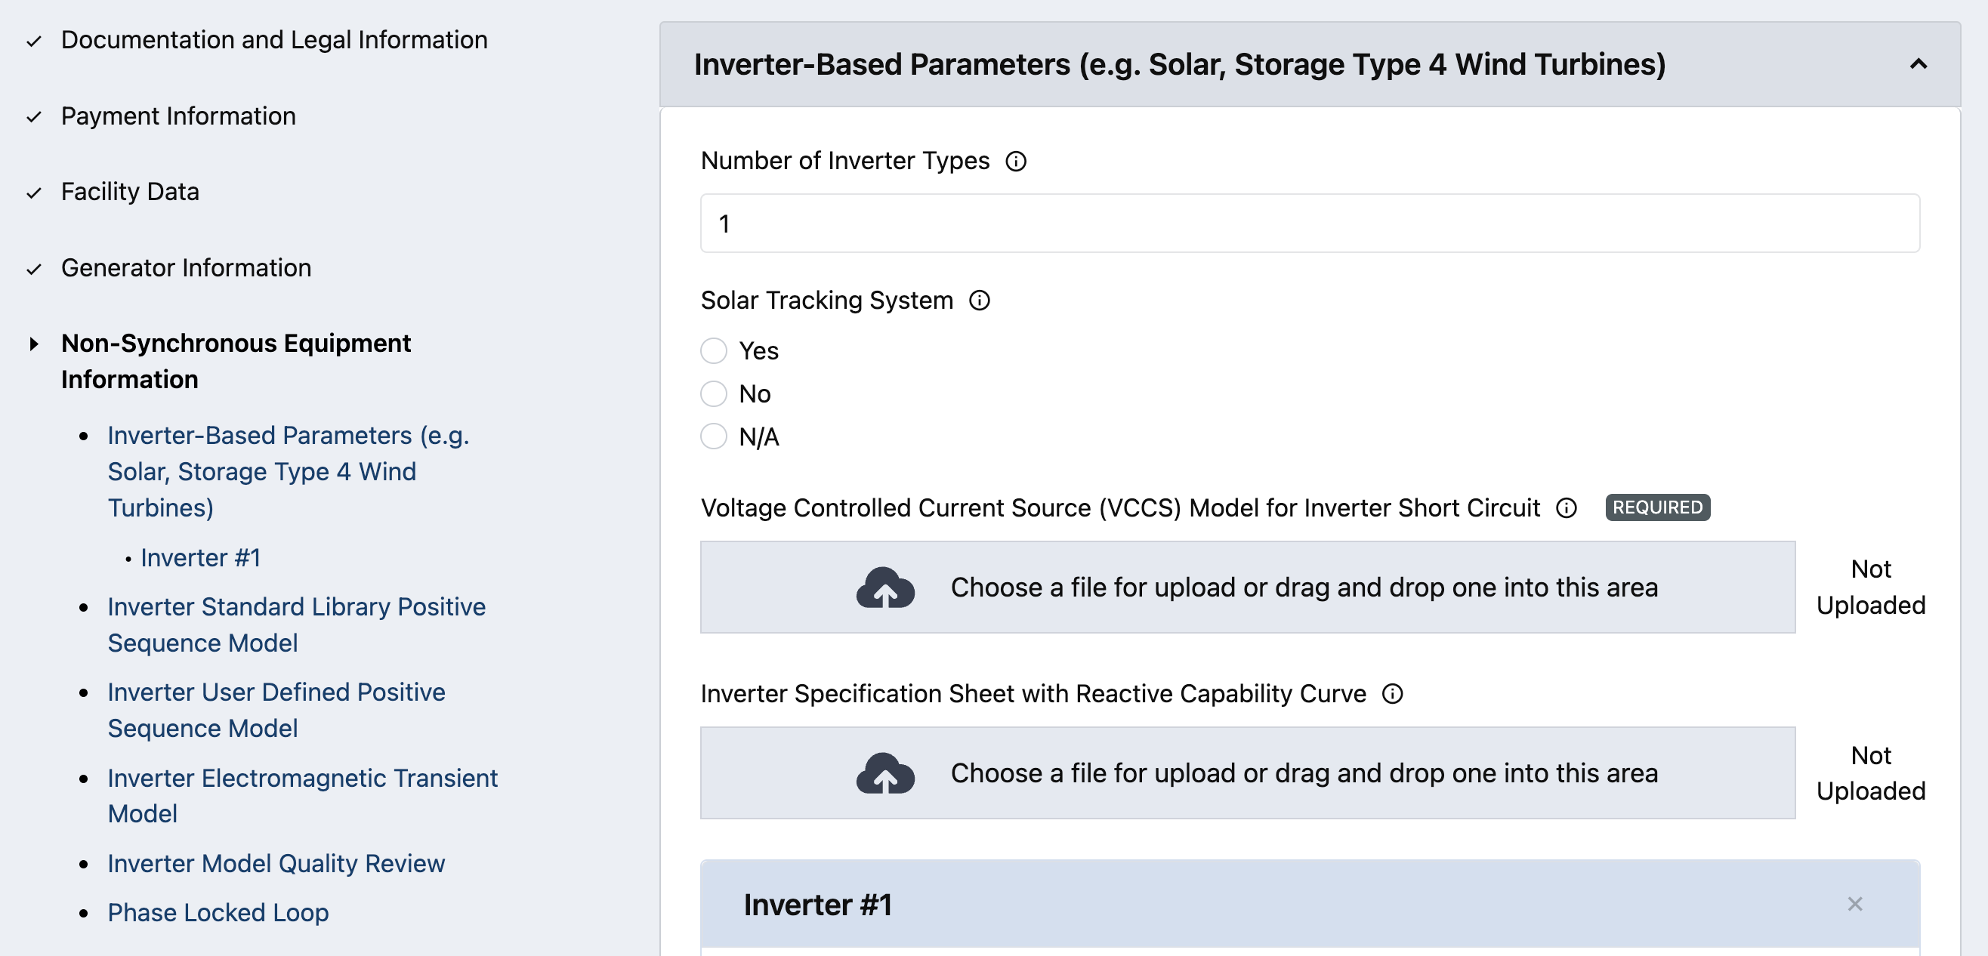
Non-Synchronous Equipment Information
Non-Synchronous Equipment Information allows to define two types of Non-Synchronous generators:
Type 1, 2, 3
Non-Synchronous Generator information
Type 4
Inverter-Based Parameters (e.g. Solar, Storage, Type 4 Wind Turbines)
Note: types can be multi-select

Slide 34
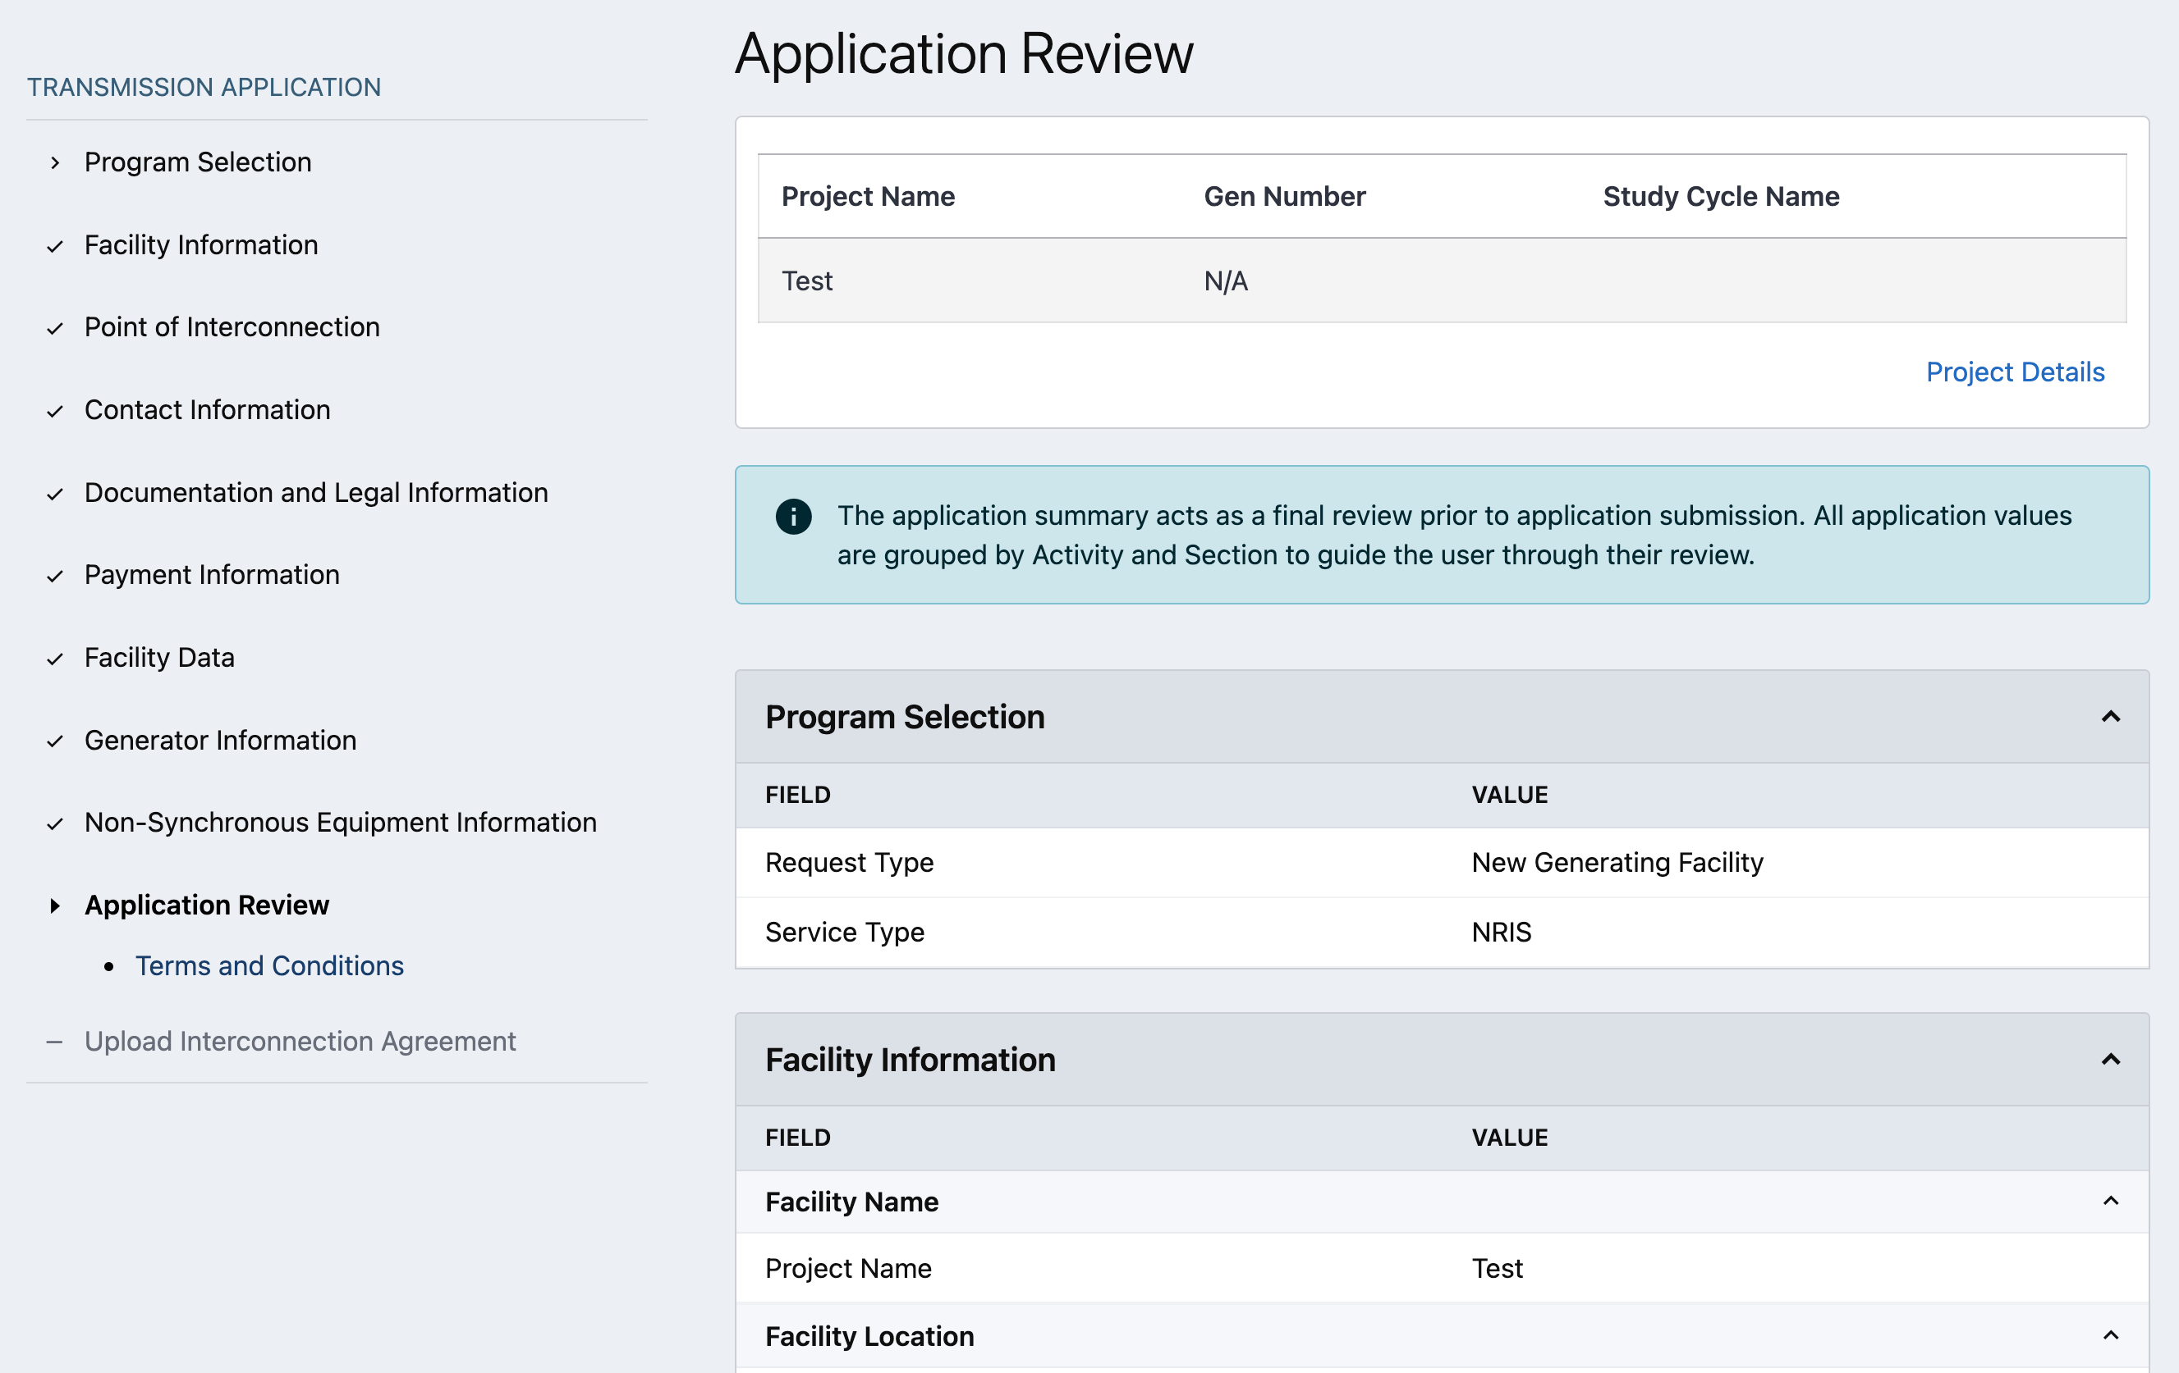
Application Review
Application Review provides the applicant an opportunity to review all of the information entered on the application. The applicant should review all data fields for accuracy before agreeing to the Terms and Conditions and submitting the application.
The applicant can navigate back into any previous application activity via the breadcrumbs in the left page margin to make changes to the application before submission.
Note: screen shot represents a Test environment before Study Cycles are defined.

Slide 35
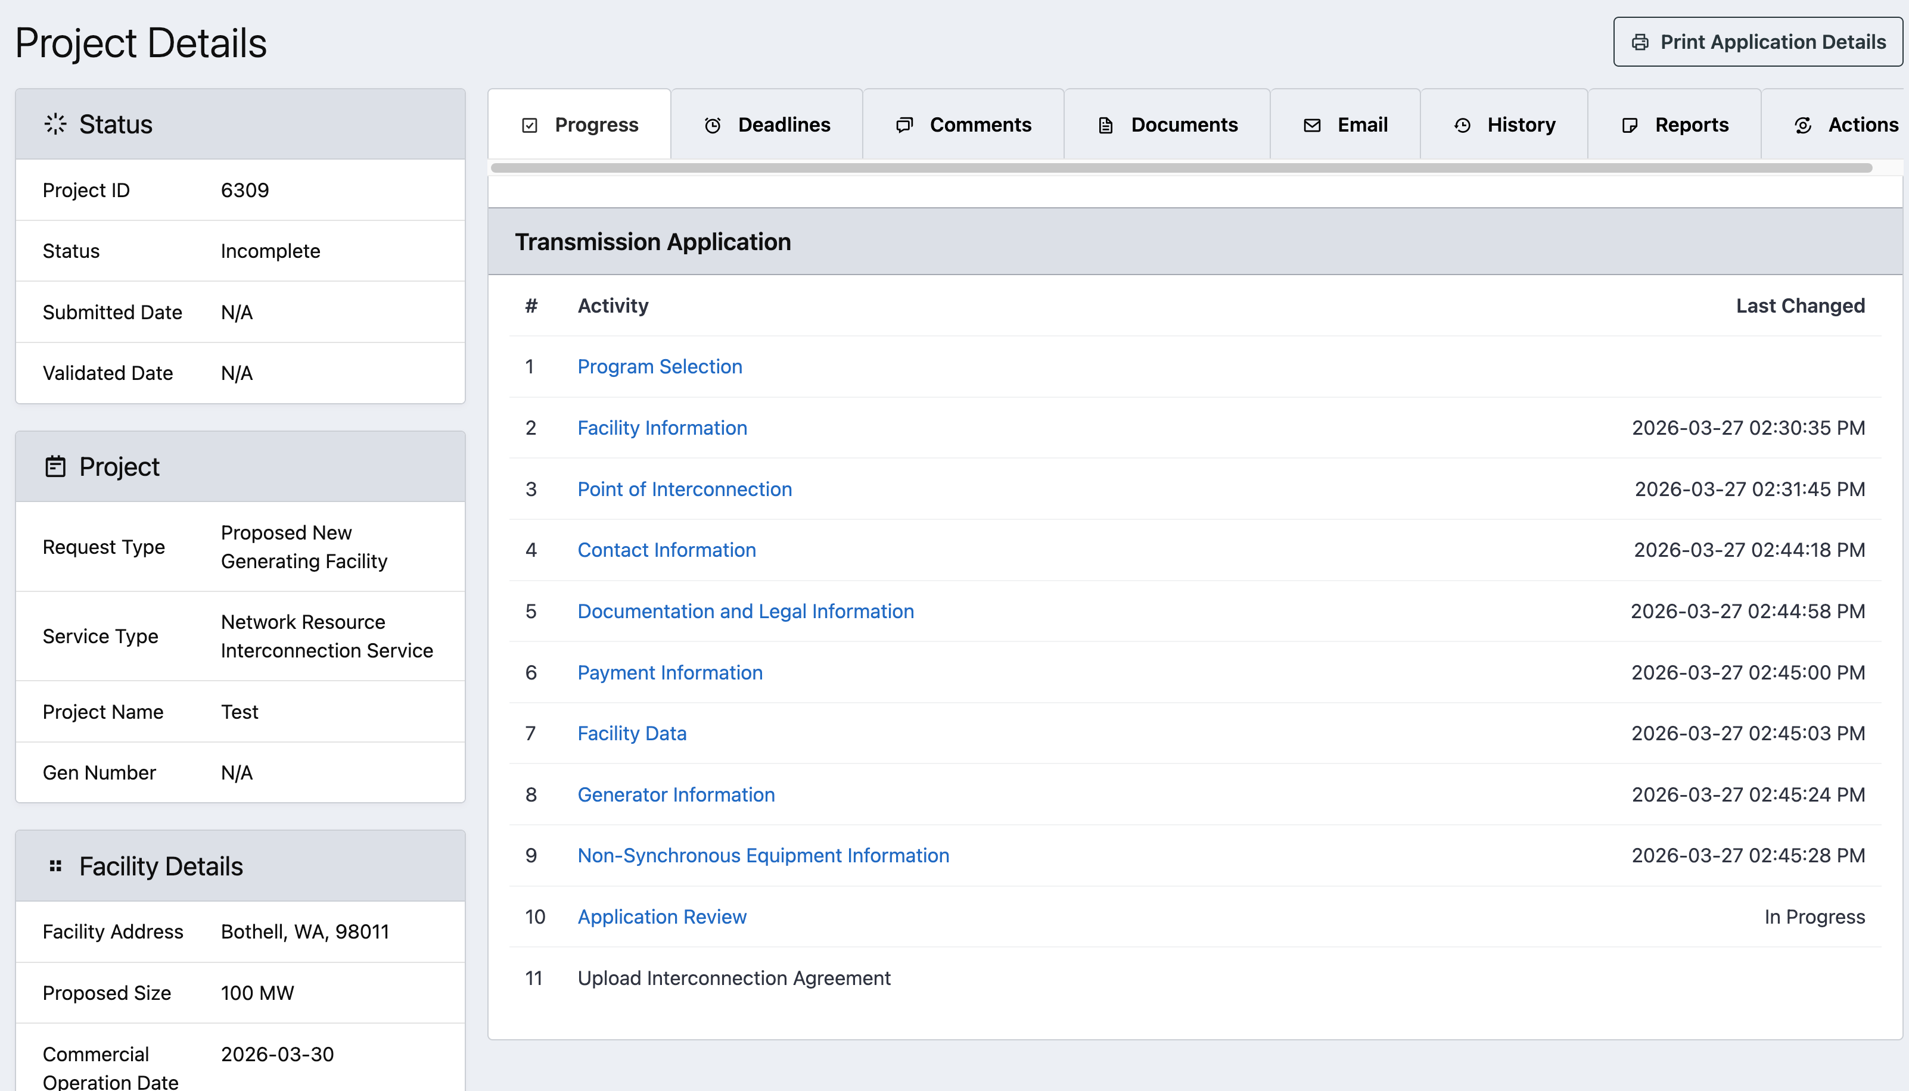
Project Details
The Project Details page provides both summary and detailed information, and displays the progress of the Interconnection Application.
Access to this view depends on a user’s affiliation with the project and permissions in the system.
Tabs in this view are available based on user permissions and provide the user with various actions to view regarding the application.
The Completeness Review action is initiated from this page.

Slide 36
Document Upload/Download

Slide 37
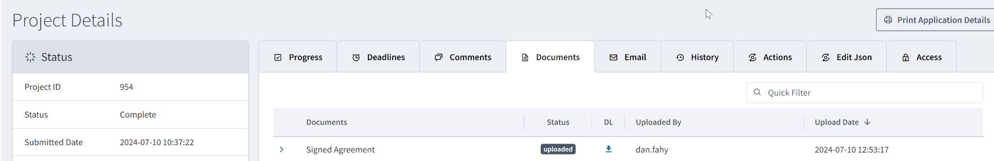
Fully Executed Signed Agreement
Once the tariff form is fully executed (signed by the Customer and SPP) the document can be found under the Documents tab on the Project Details page of the application.
The fully executed document will be titled Signed Agreement.

Slide 38
Corrections

Slide 39
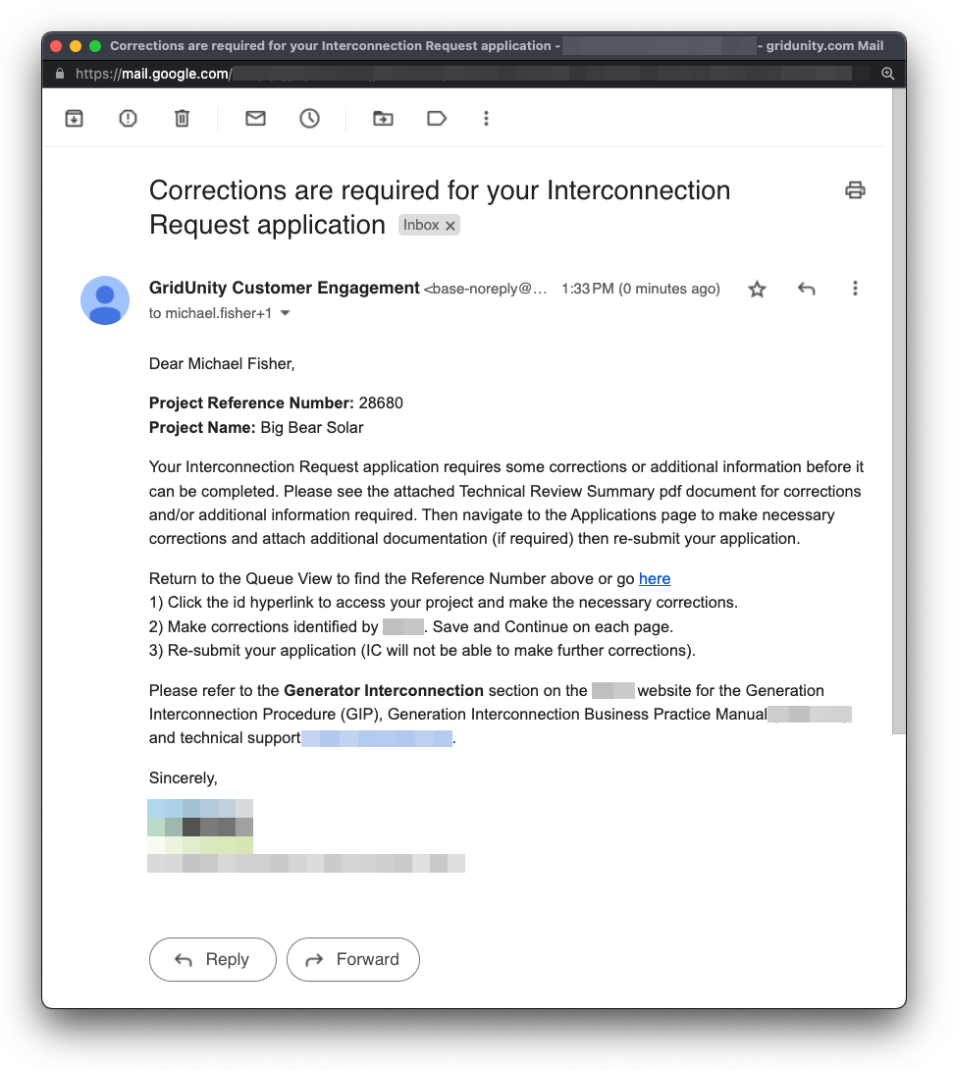
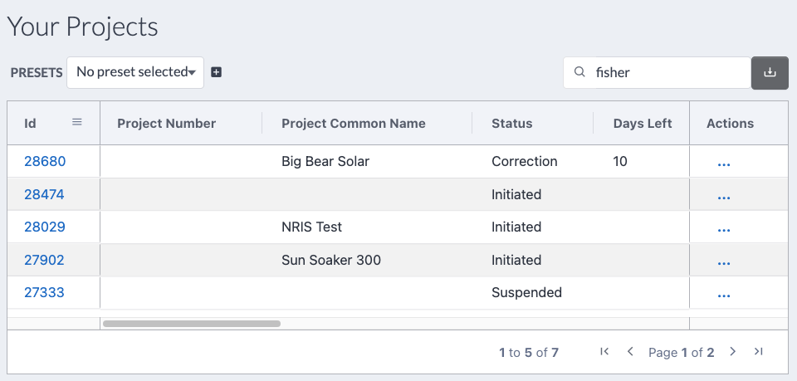
Completeness Review | Corrections
Applications that do not pass completeness review are sent back to the interconnection applicant for corrections.
This process is initiated by the system sending an email notification of the review results and required action.

Slide 40
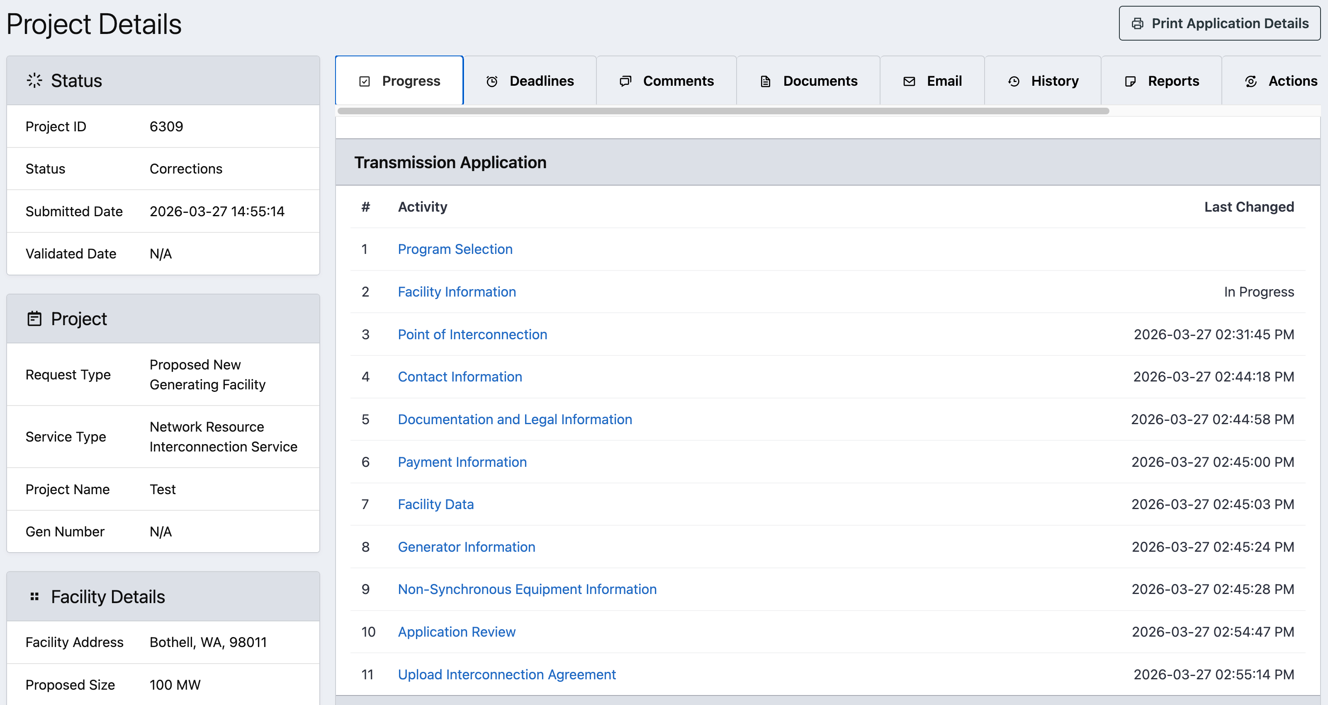
Completeness Review | Corrections
After clicking project ID on My Projects page, the Application Details page will allow the user to re-enter and edit the application to correct the flagged deficiencies.

Slide 41
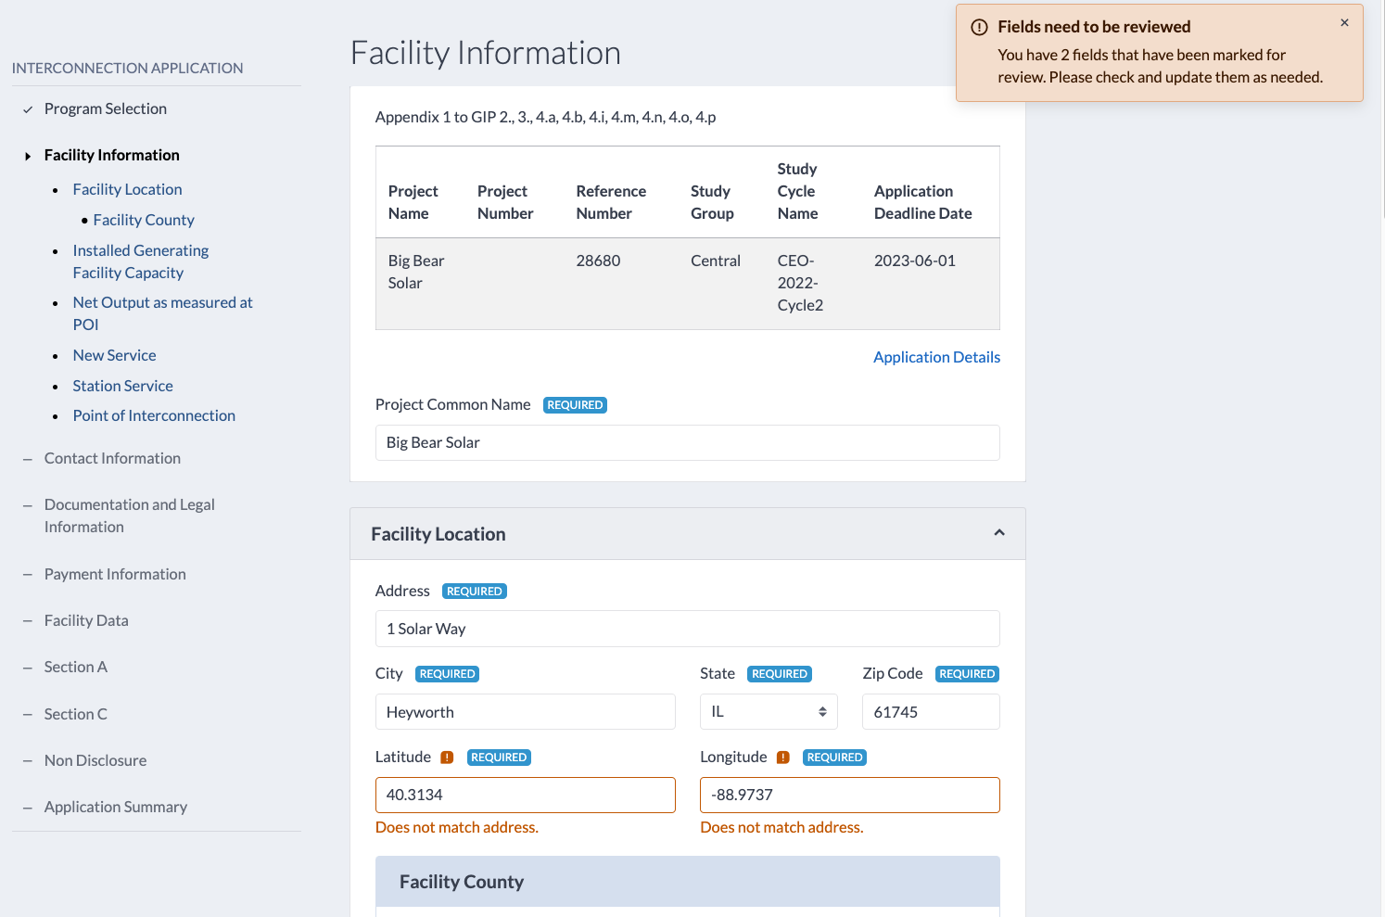
Completeness Review | Corrections
Upon re-entering application, system guides user to alert them to fields requiring corrections by displaying flag indicators as well as the reviewer’s comments.

Slide 42
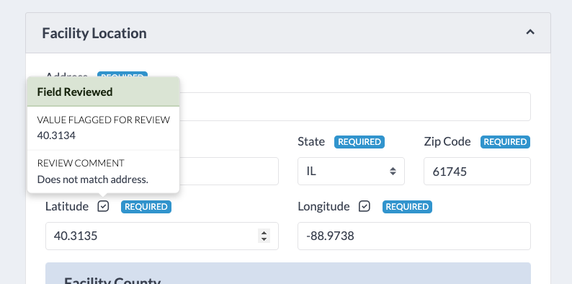
Completeness Review | Corrections
Fields that have been corrected will display an updated flag icon and the prior value as well as reviewer comment remain accessible to the applicant for reference.

Slide 43
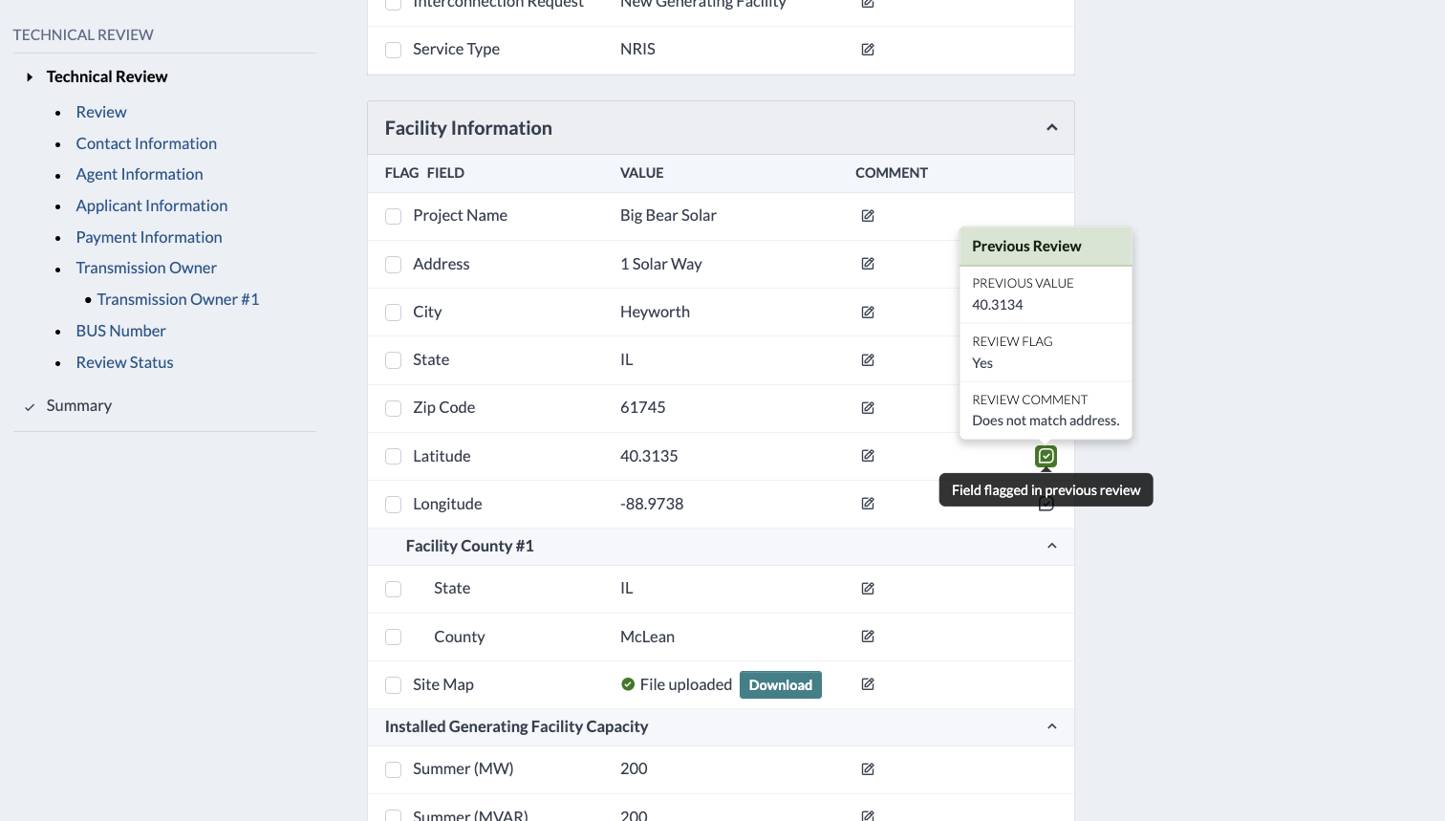
Completeness Review | Corrections Review
Corrections Review acts as a second round of completeness review after the applicant has made changes.
Previously flagged fields that have been corrected by applicant are indicated accordingly.
Reviewer can see previous field value and comment for reference in Corrections Review process.
This process can continue iteratively until all issues are resolved.

Slide 44
My Projects

Slide 45
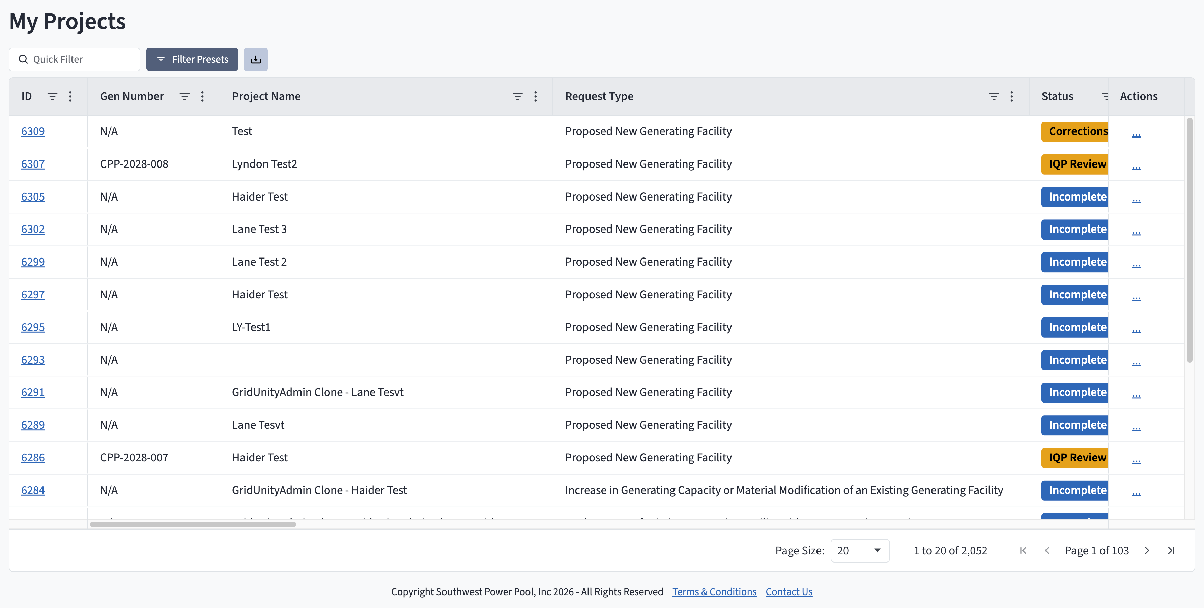
My Projects
The My Projects page provides a summary view to all users for the projects they have access to.
My Projects functionality includes:
View customization via column selection, column order, sort, search, and preset filter functions
Access to individual Project Details via the ID hyperlink
Project data export (Excel or CSV file)
Accessing project-specific user actions

Slide 46
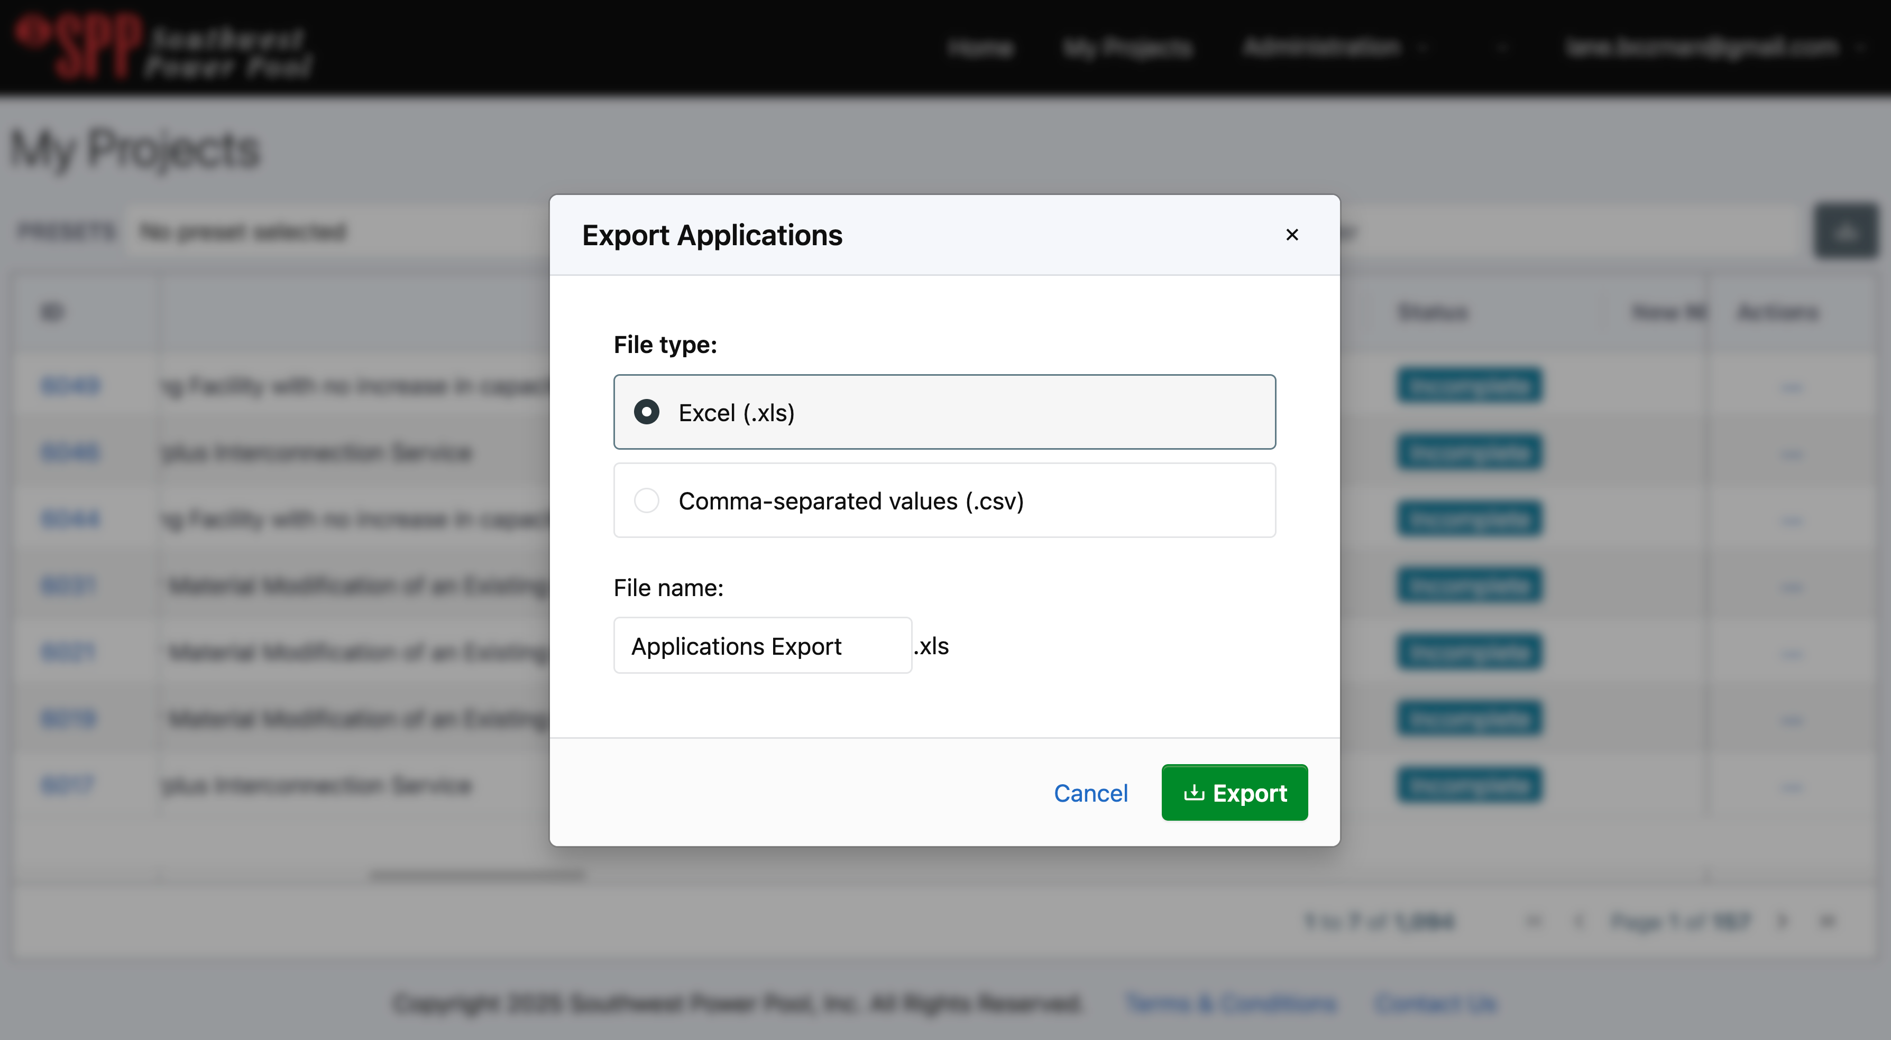
My Projects | Data Export
Export data from the My Projects page by:
Clicking the export button,
selecting the export file type,
and clicking “Export”.
1
2
3

Slide 47
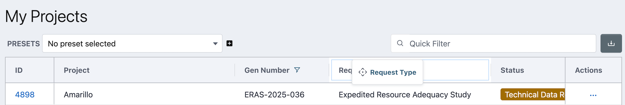
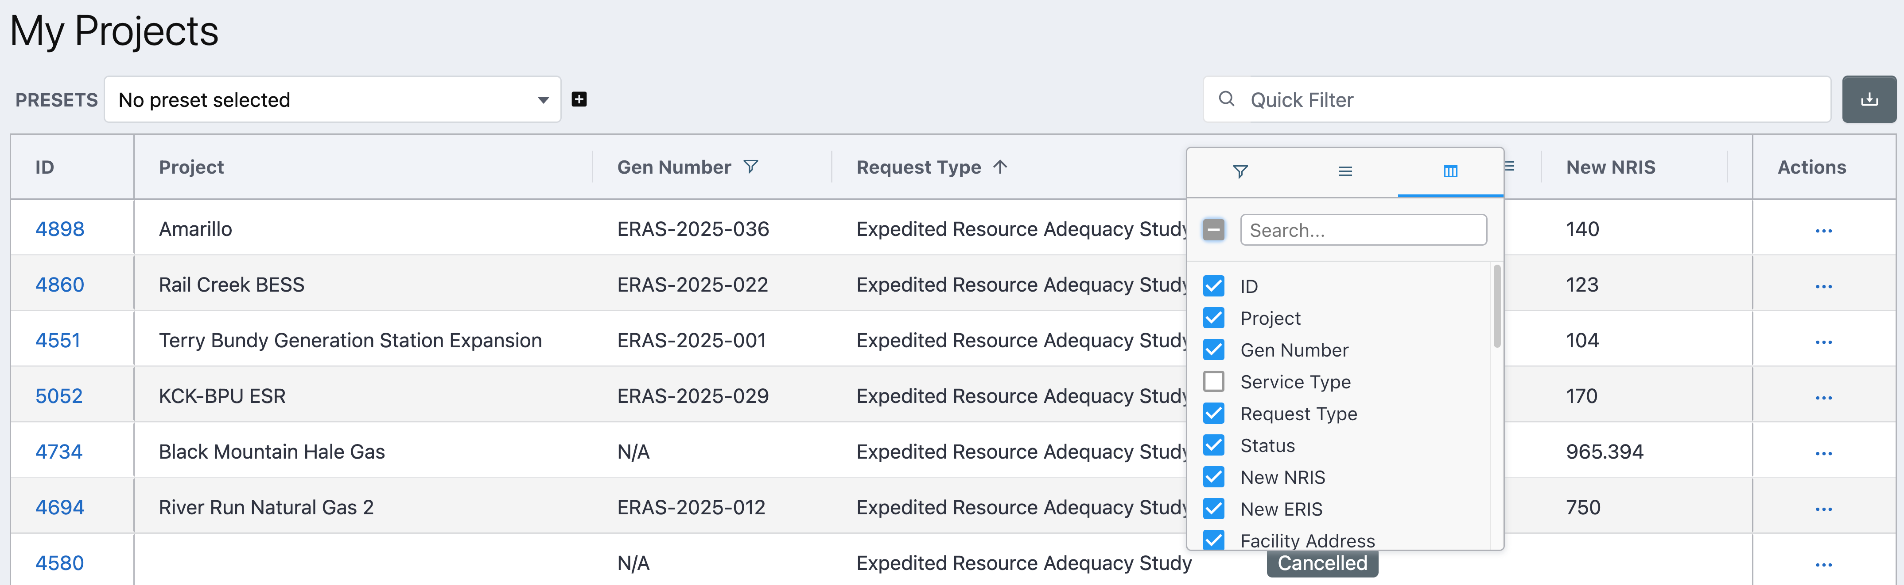
My Projects | View Customization
1
View customization options on My Projects can be performed by:
Changing column order
Changing column selection
Application search
Filtering on column values
3
2
4

Slide 48
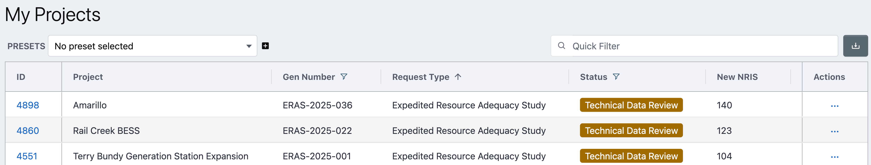
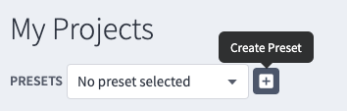
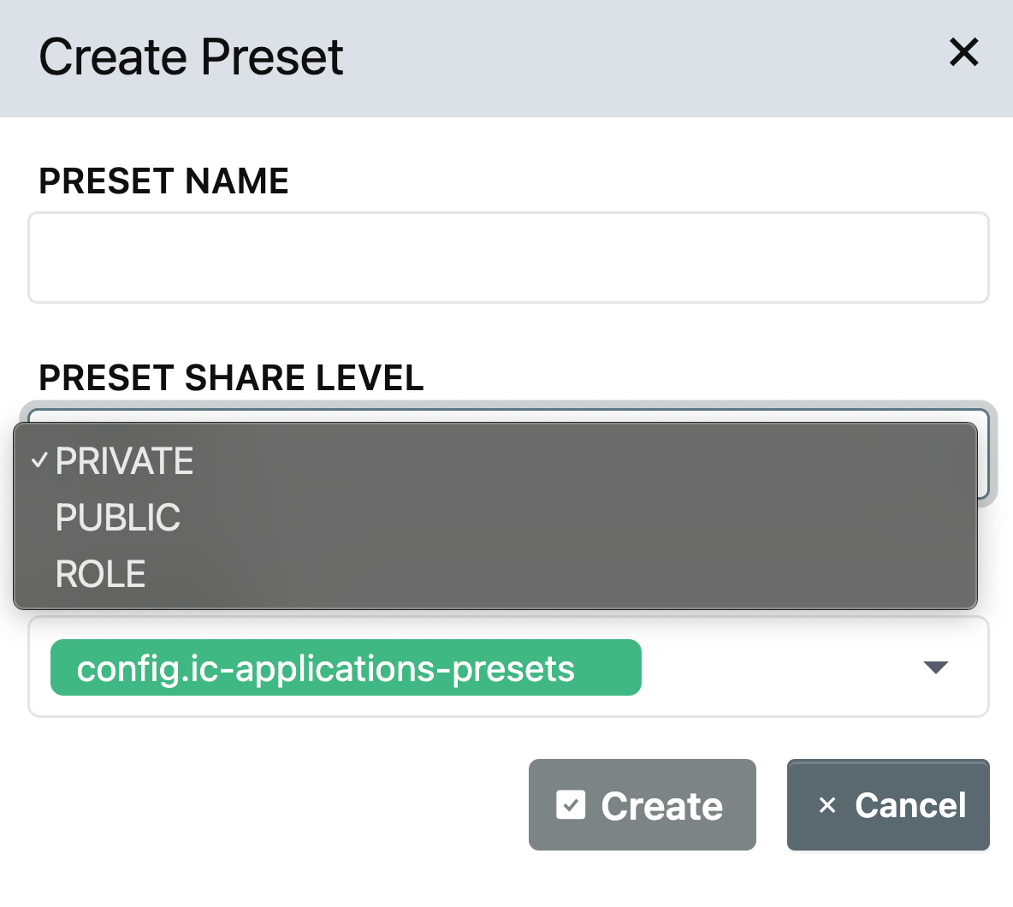
My Projects | Saving Preset Filters
Once view customization has been configured, those settings can be saved as a Preset View Filter for easy, repeatable access. To save a preset filter:
1. Filter/customize the page view as desired
2. Click the “+” to Create Preset
3. Name the preset and click the “✓” to save
4. Note: Preset filters can be saved to the My Projects page (config.ic-applications-presets) and/or to the home (dashboard) page (config.dashboard-outstanding-actions)
5. Presets can also be saved privately (only visible to acting user) or publicly (visible to all users)
1
1
2
1
3
5
4

Slide 49
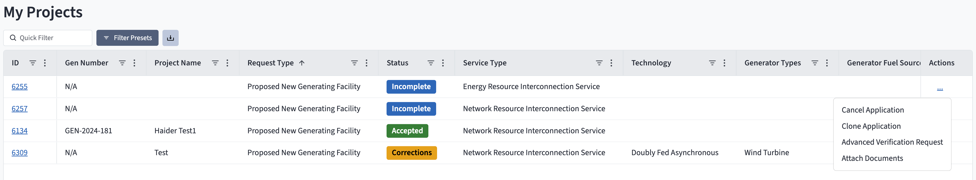
My Projects | User Actions
User Actions are manually initiated tasks a user (internal or external) can execute on an application. A user’s role and privileges determine which User Actions can be accessed.
User actions are available via the Actions column on a per project basis on the My Projects page.
Note: User Actions are also accessible on the Project Details page (Actions tab)

Slide 50
Need help?
Contact SPP’s Request Management System (RMS)
Email: stakeholderrelations@spp.org

